Slide 1
Clickbait + Ephys
Progress and preliminary analysis

Slide 2
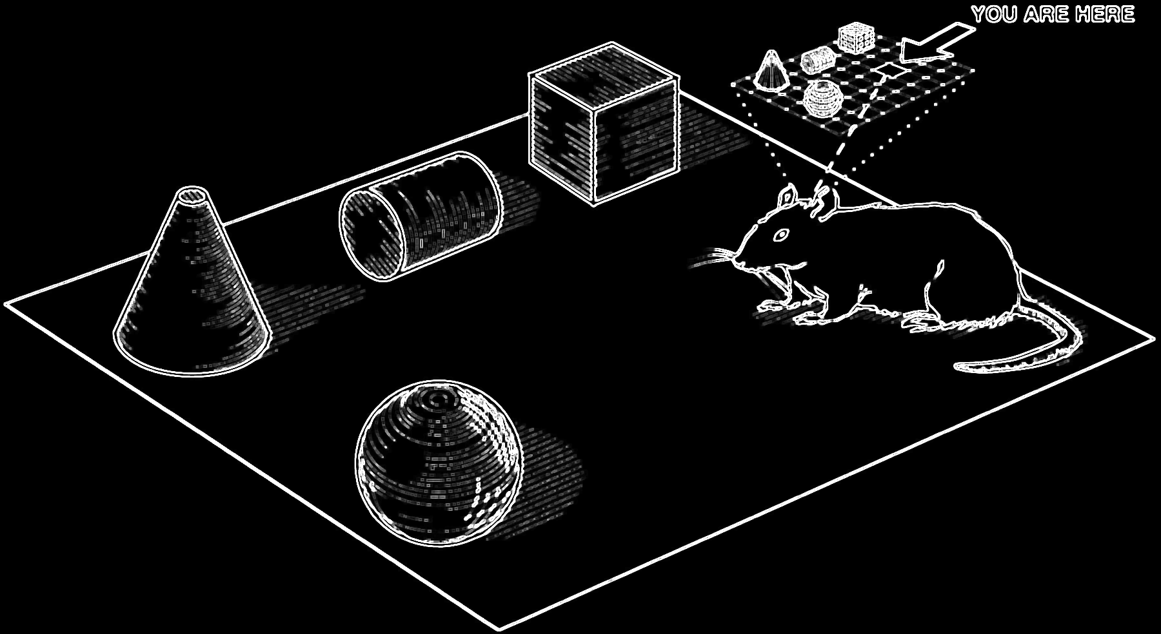
Research Questions
How does the brain interpret sensory inputs to generate purposeful behavior?
Why is place encoded in the olfactory bulb and how did it get there?
Is recurrence between primary sensory regions (olfactory bulb) and the hippocampus functionally relevant?
How might feedforward activity from olfactory bulb to hippocampus be temporally organized by local field potentials?
(Eichenbaum et al., 1999)

Slide 3
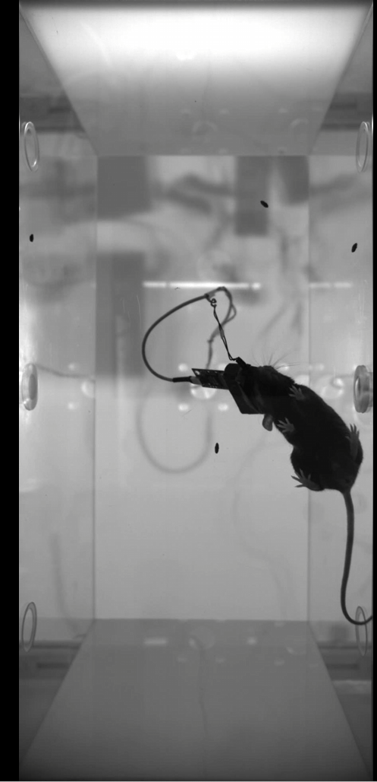
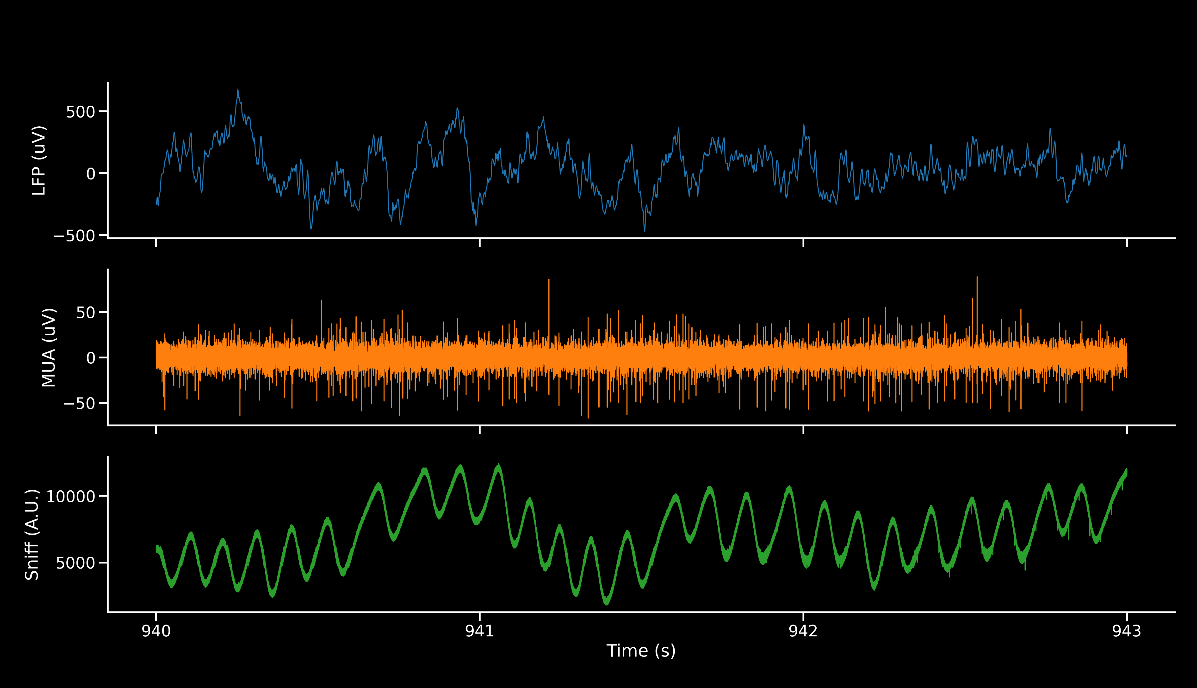
Data acquisition

Slide 4
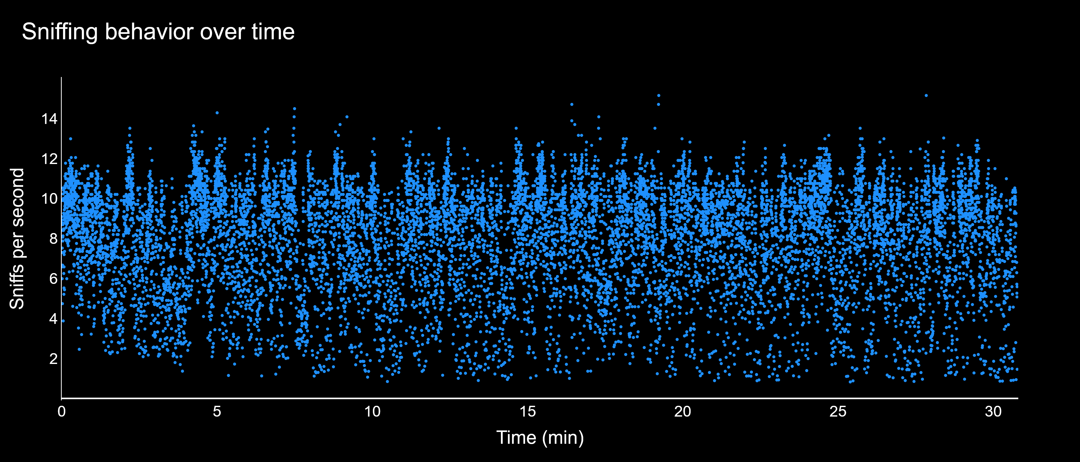
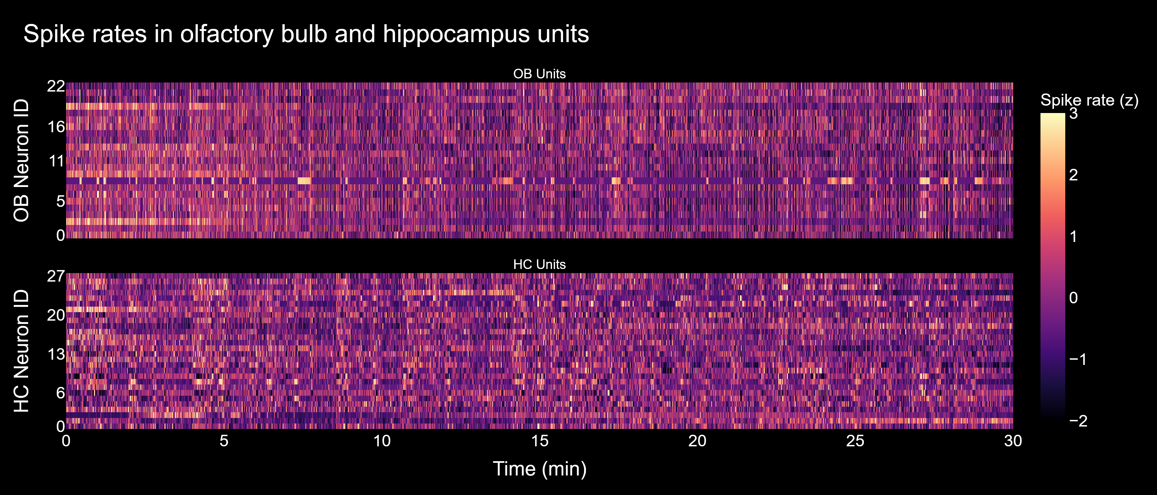
Data preprocessing
Sniffing behavior
Sniffing behavior captured with inhalation onset and sniff rate
Position tracking from bottom-up video
Spike sorting with Kilosort4 and manual curation in Phy2
Smoothed and normalized spike rates
Population activity
6002/0

Slide 5
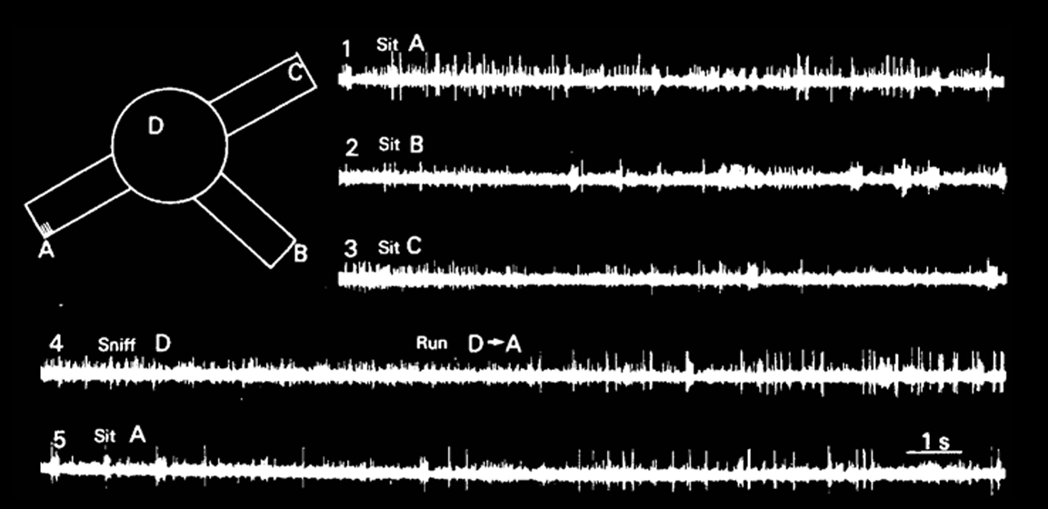
Place Cells
We conducted qualitative analysis to identify putative place cells across both OB and Hippocampus (HC).
Trained a CNN to identify candidates from 1518 rate maps.
We found many putative place cells in HC, few to none in OB.
(O’Keefe & Nadel 1978)

Slide 6
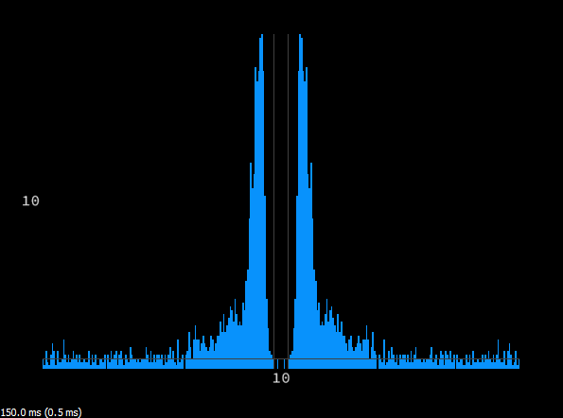
Single Units
Units detected by Kilosort4 showing few-to-zero refractory period violations.
Single units in OB were rare in our recordings.

Slide 7
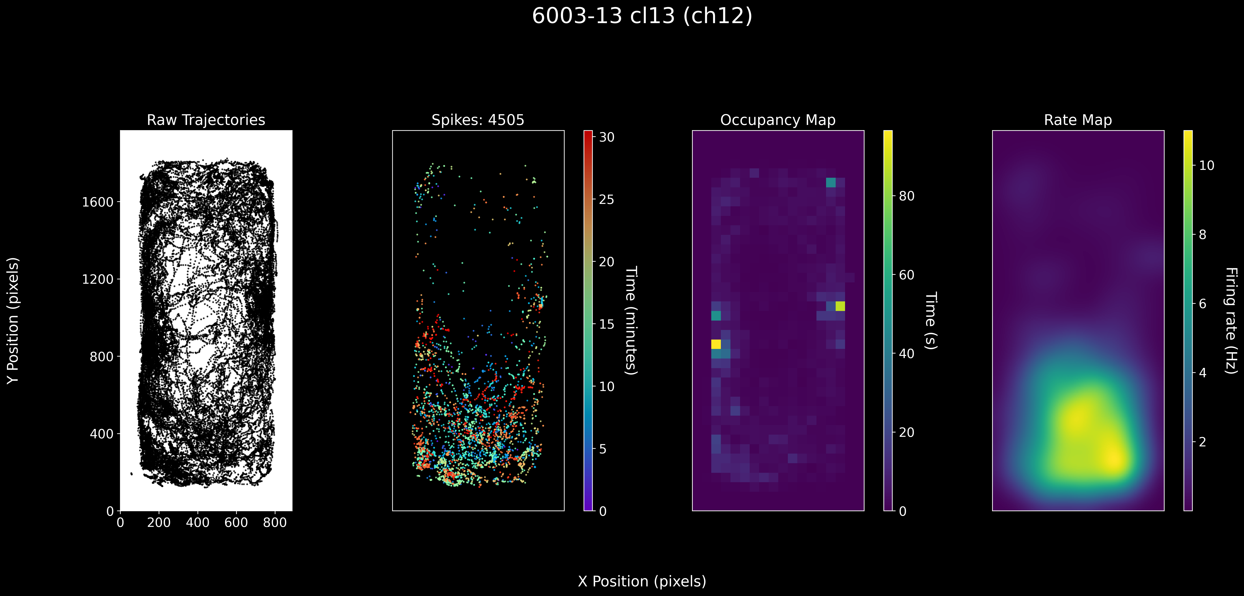

Slide 8
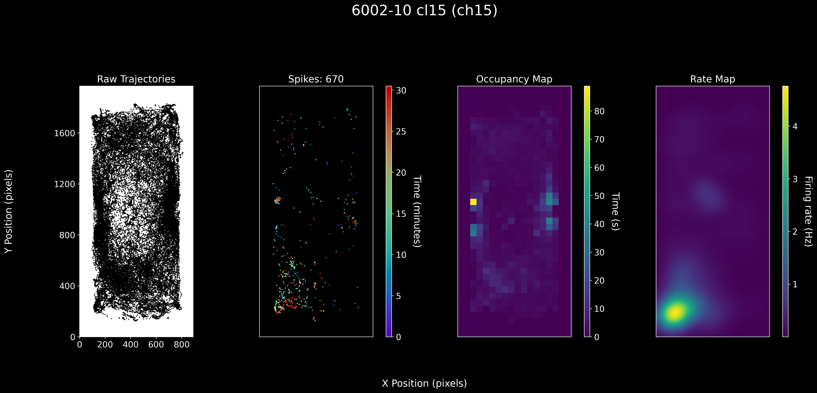

Slide 9
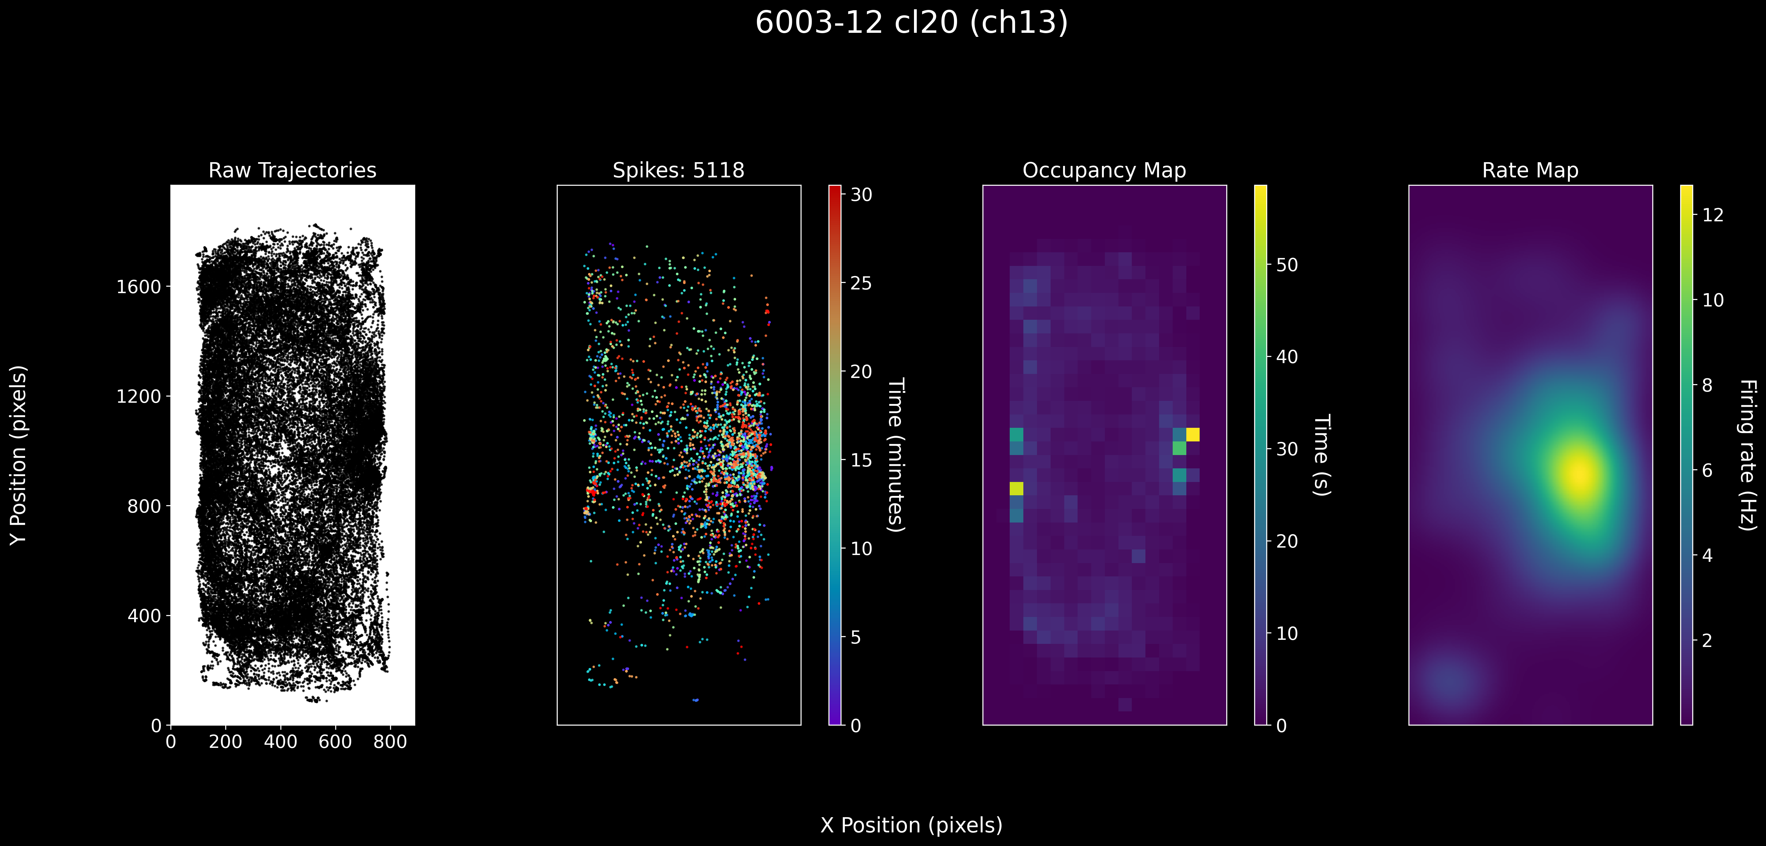

Slide 10
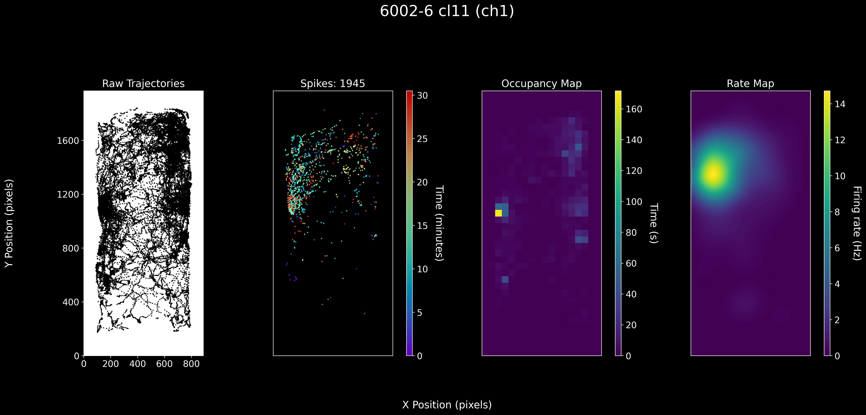

Slide 11
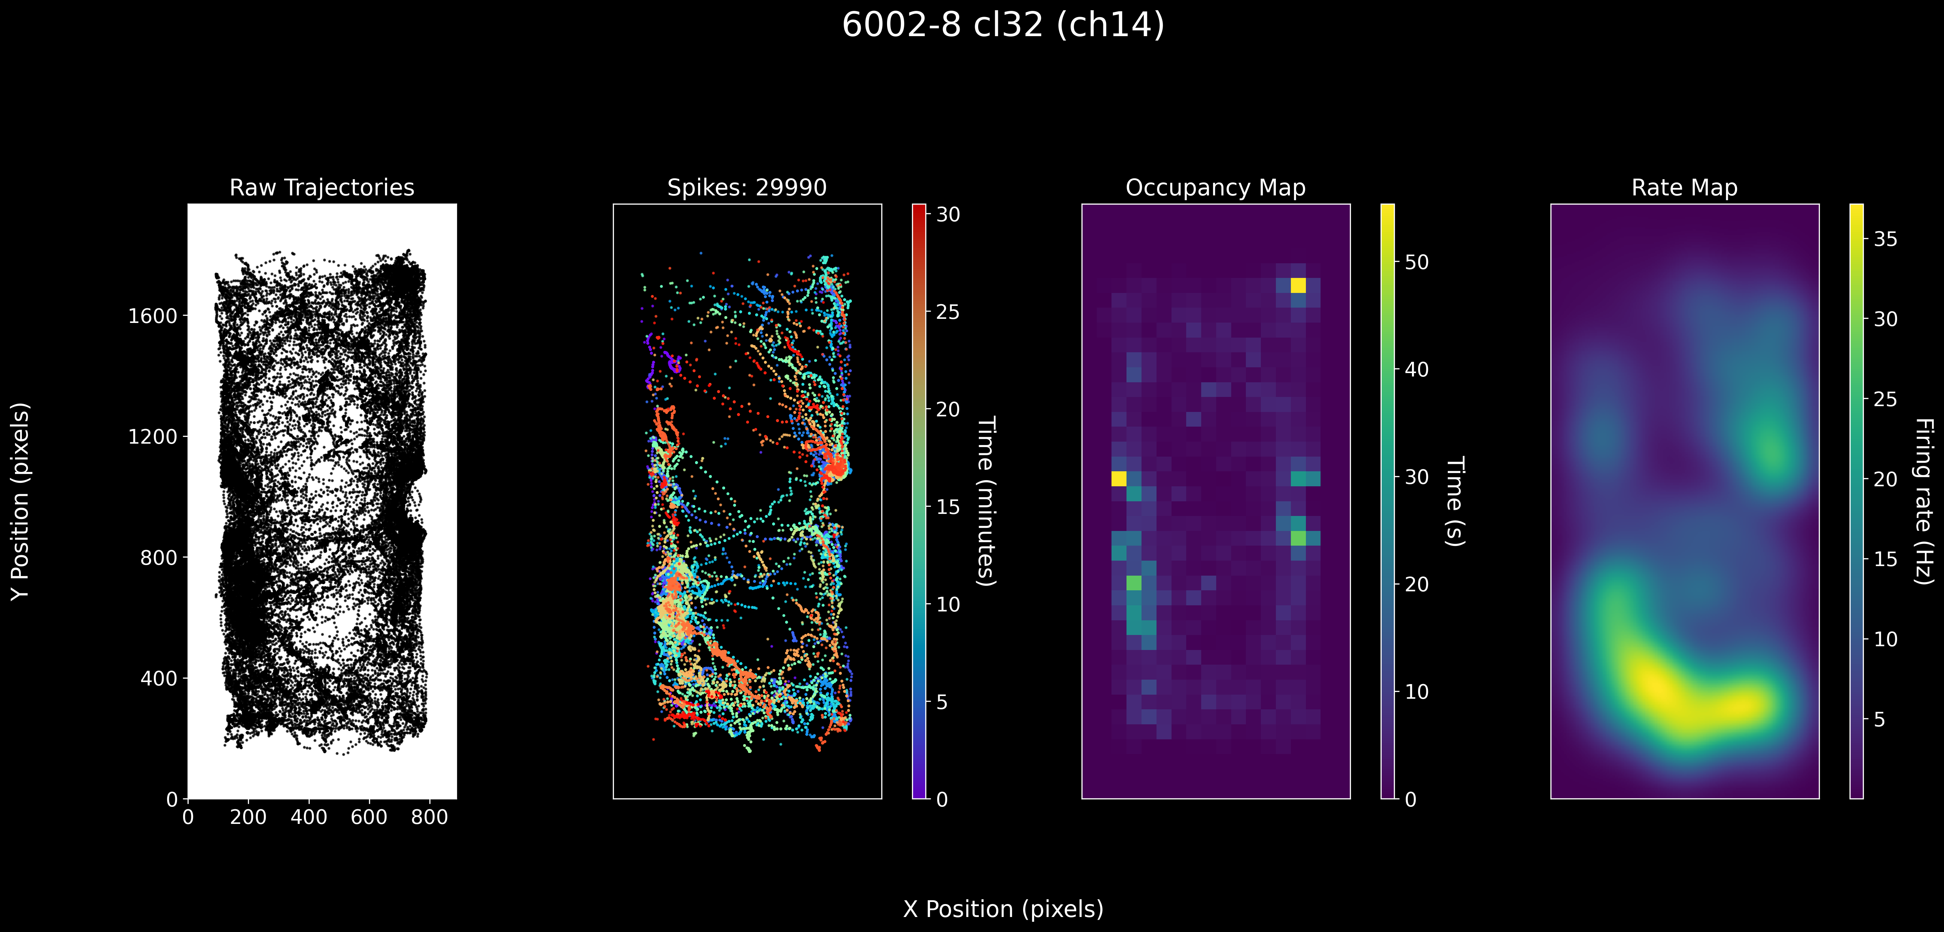

Slide 12
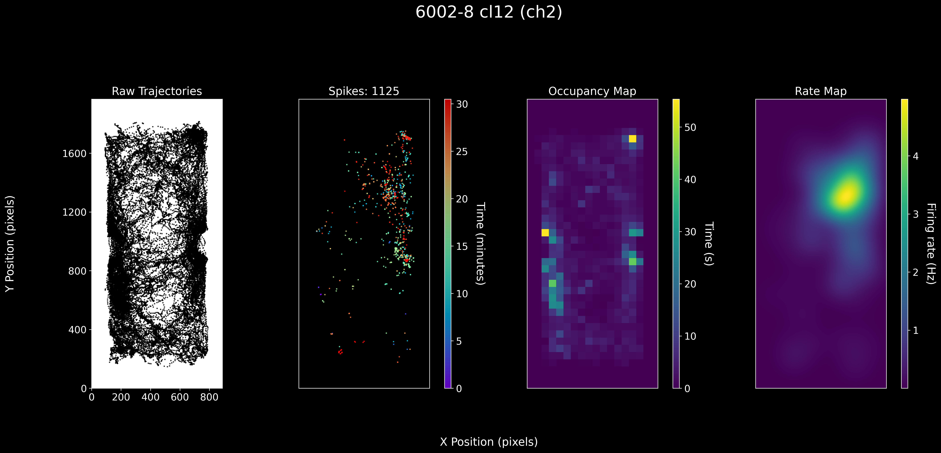

Slide 13
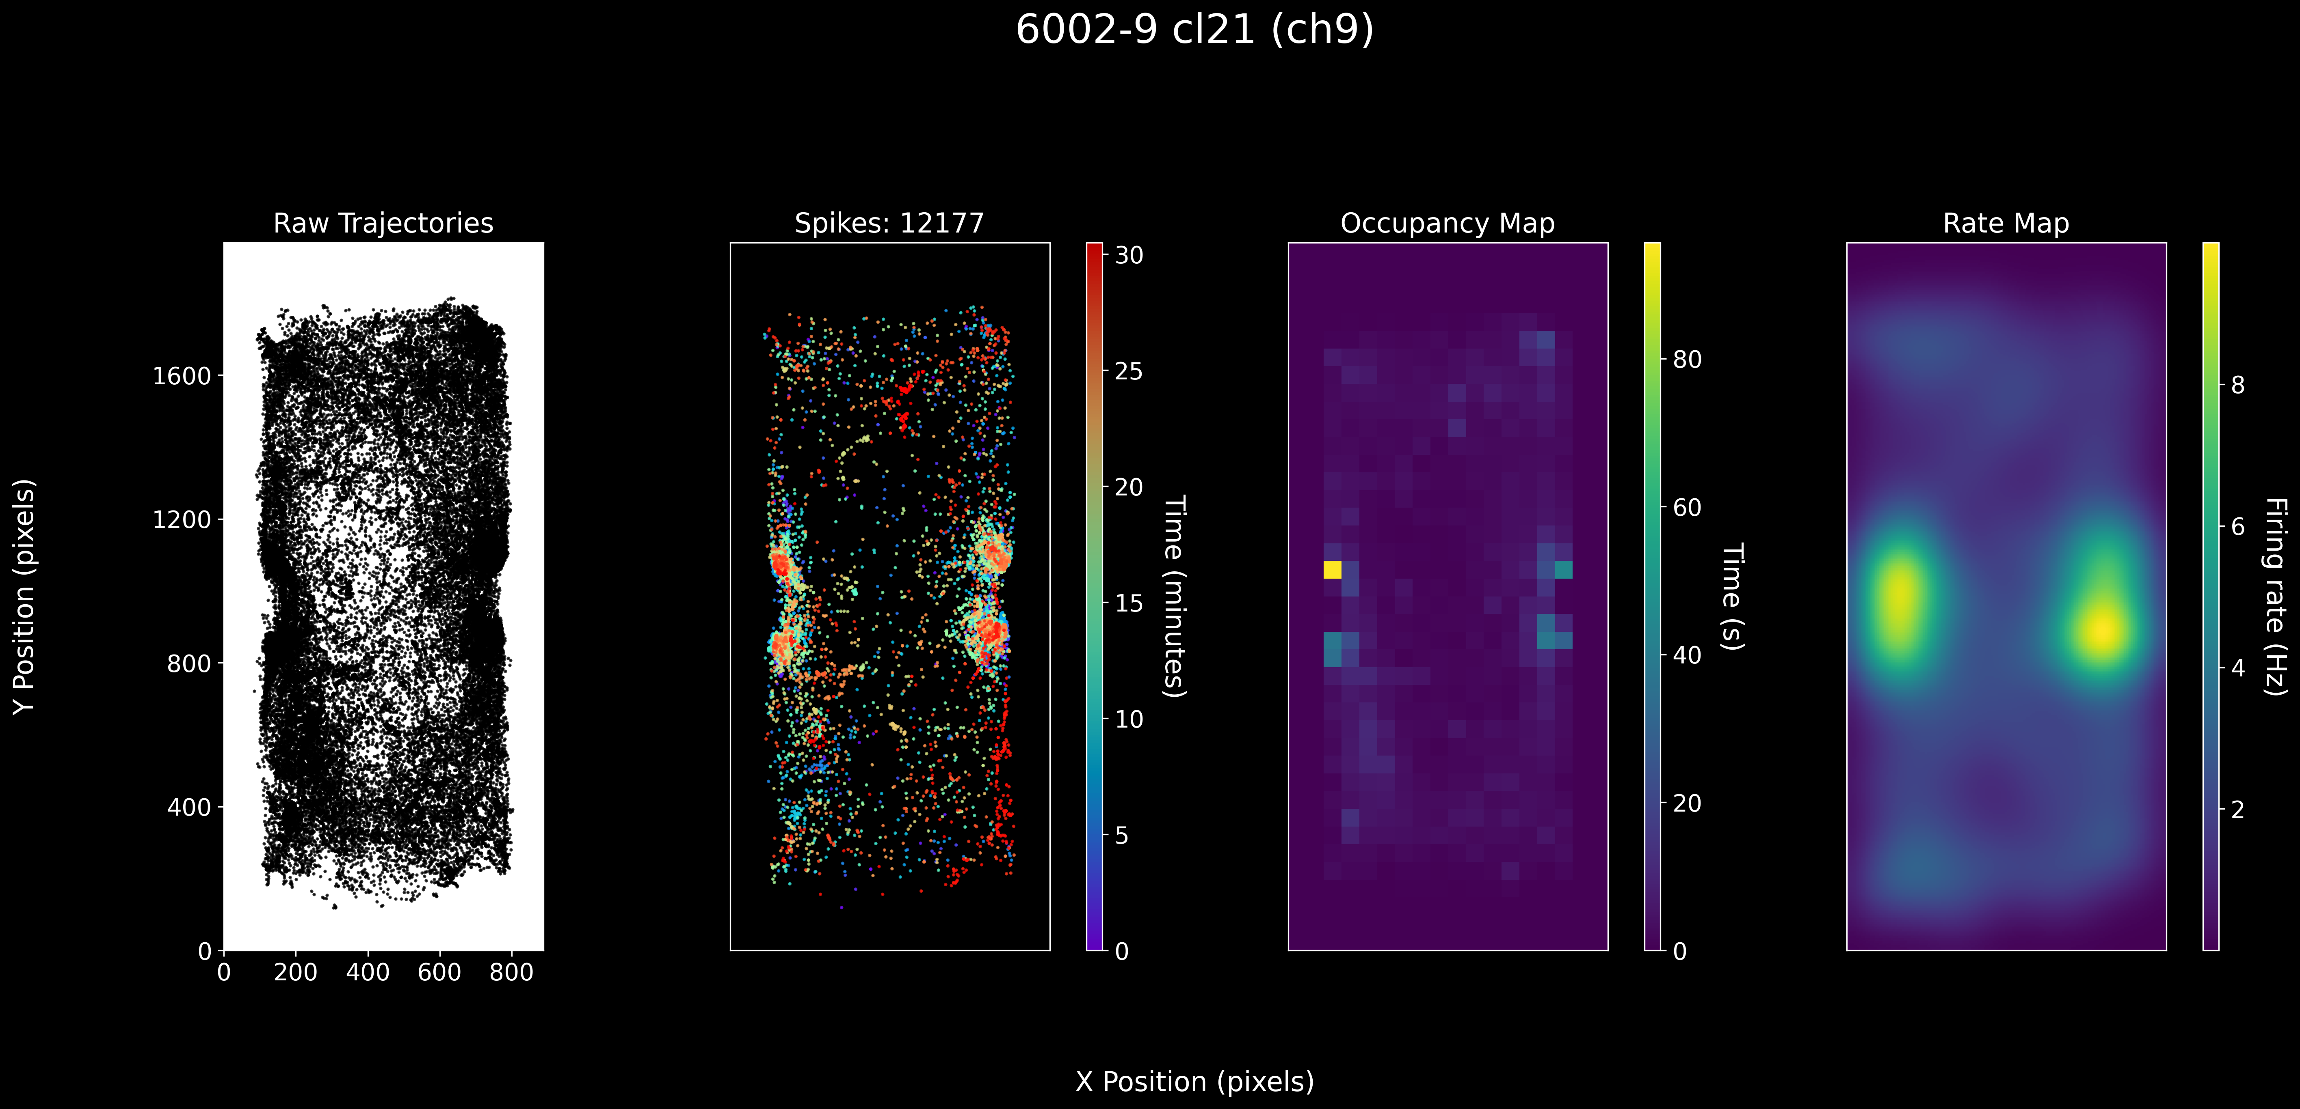

Slide 14
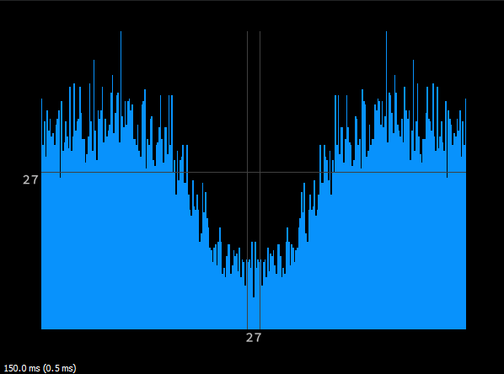
Multi Unit Activity (MUA)
Most OB units were MUAs
Many MUAs showed place tuning, but they were in HC.
Some OB MUAs showed spatiotemporally localized firing, but did not appear to be place cells.

Slide 15
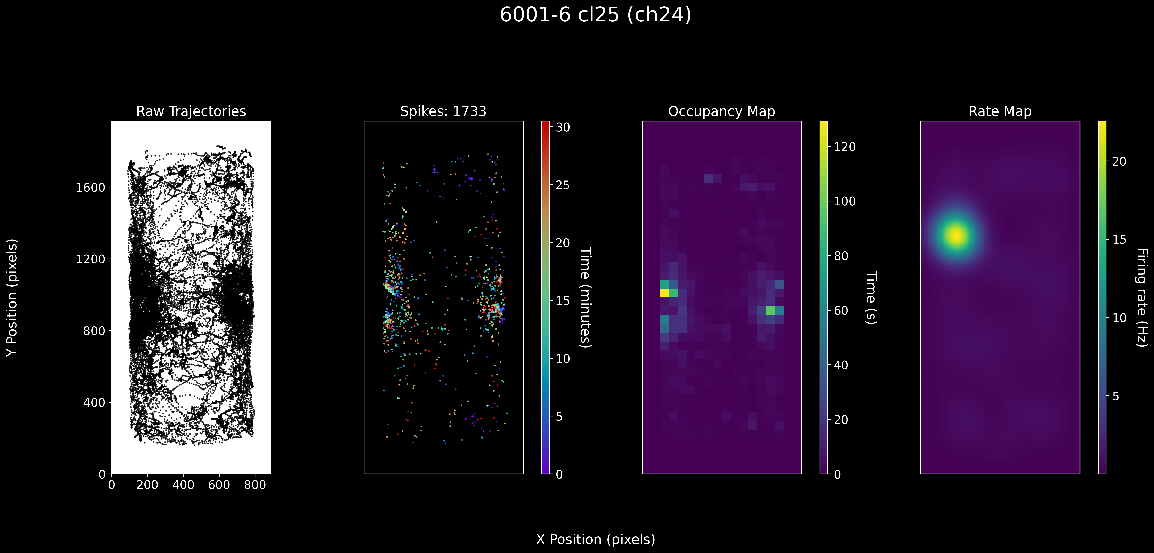

Slide 16
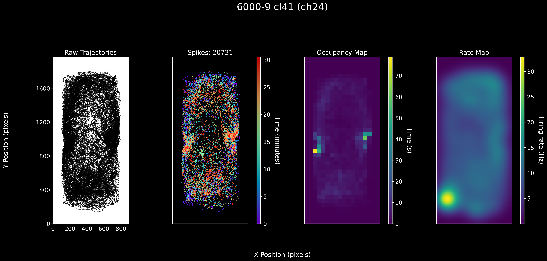

Slide 17
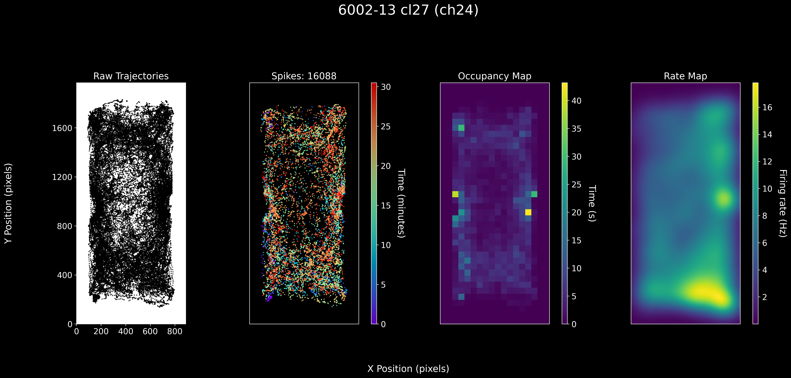

Slide 18
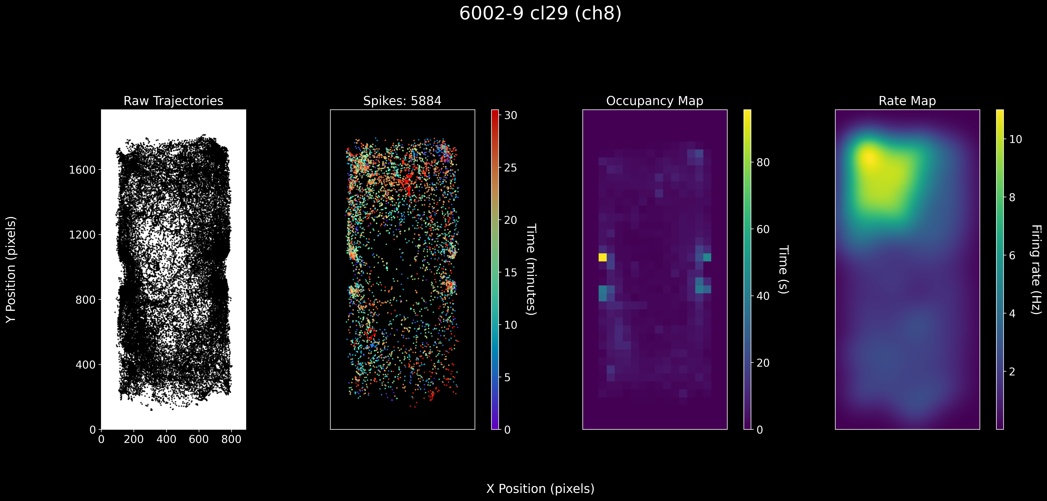

Slide 19
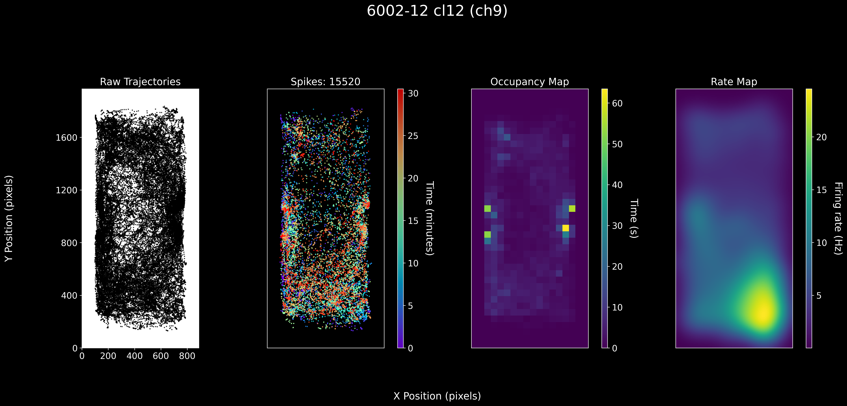

Slide 20
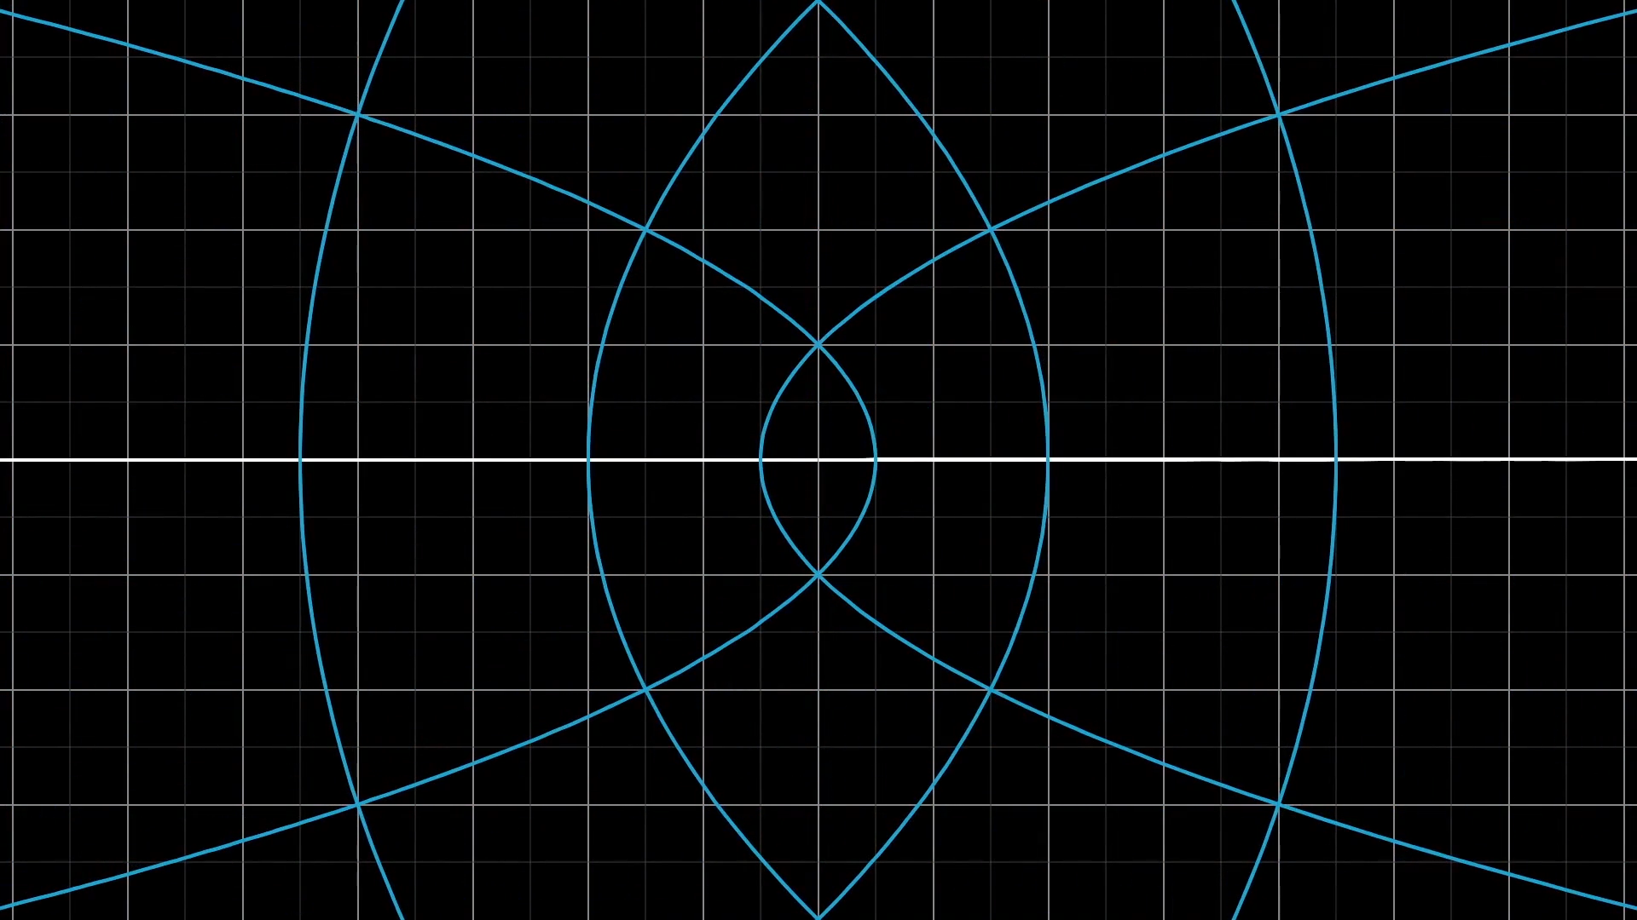

Population embeddings
Neural firing rates were computed in 100ms bins and smoothed with a gaussian filter ($σ=2.5$)
Population firing rate vectors were embedded onto lower dimensional space
PCA reduces the dimensionality by maximizing the explained variance in the linear sense
UMAP utilizes a graph-based algorithm to preserve structure in a predefined metric space (cosine distance)
3blue1brown

Slide 21
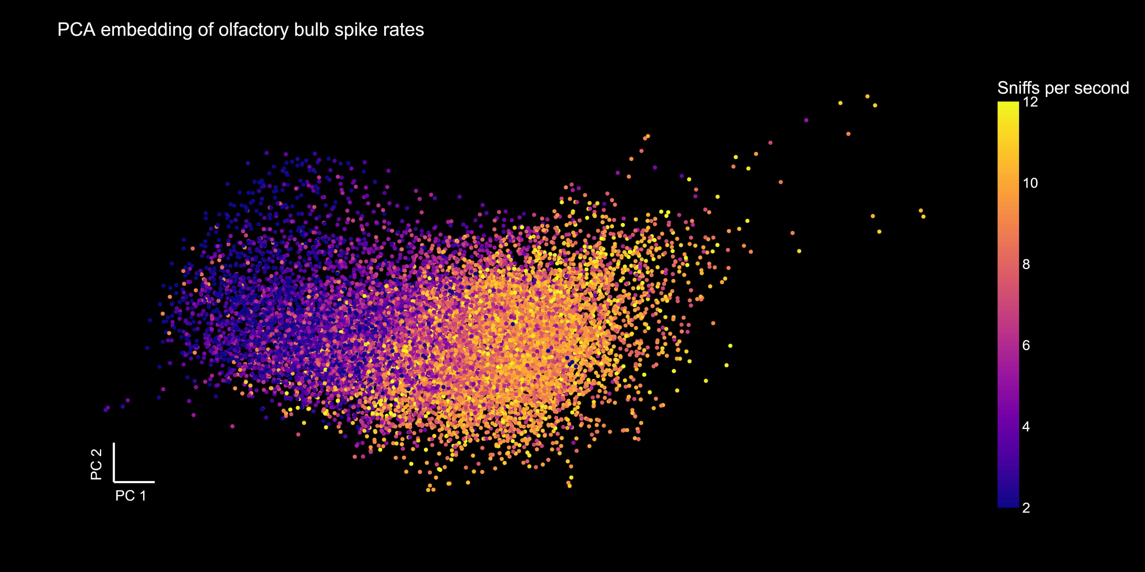
6002/0

Slide 22
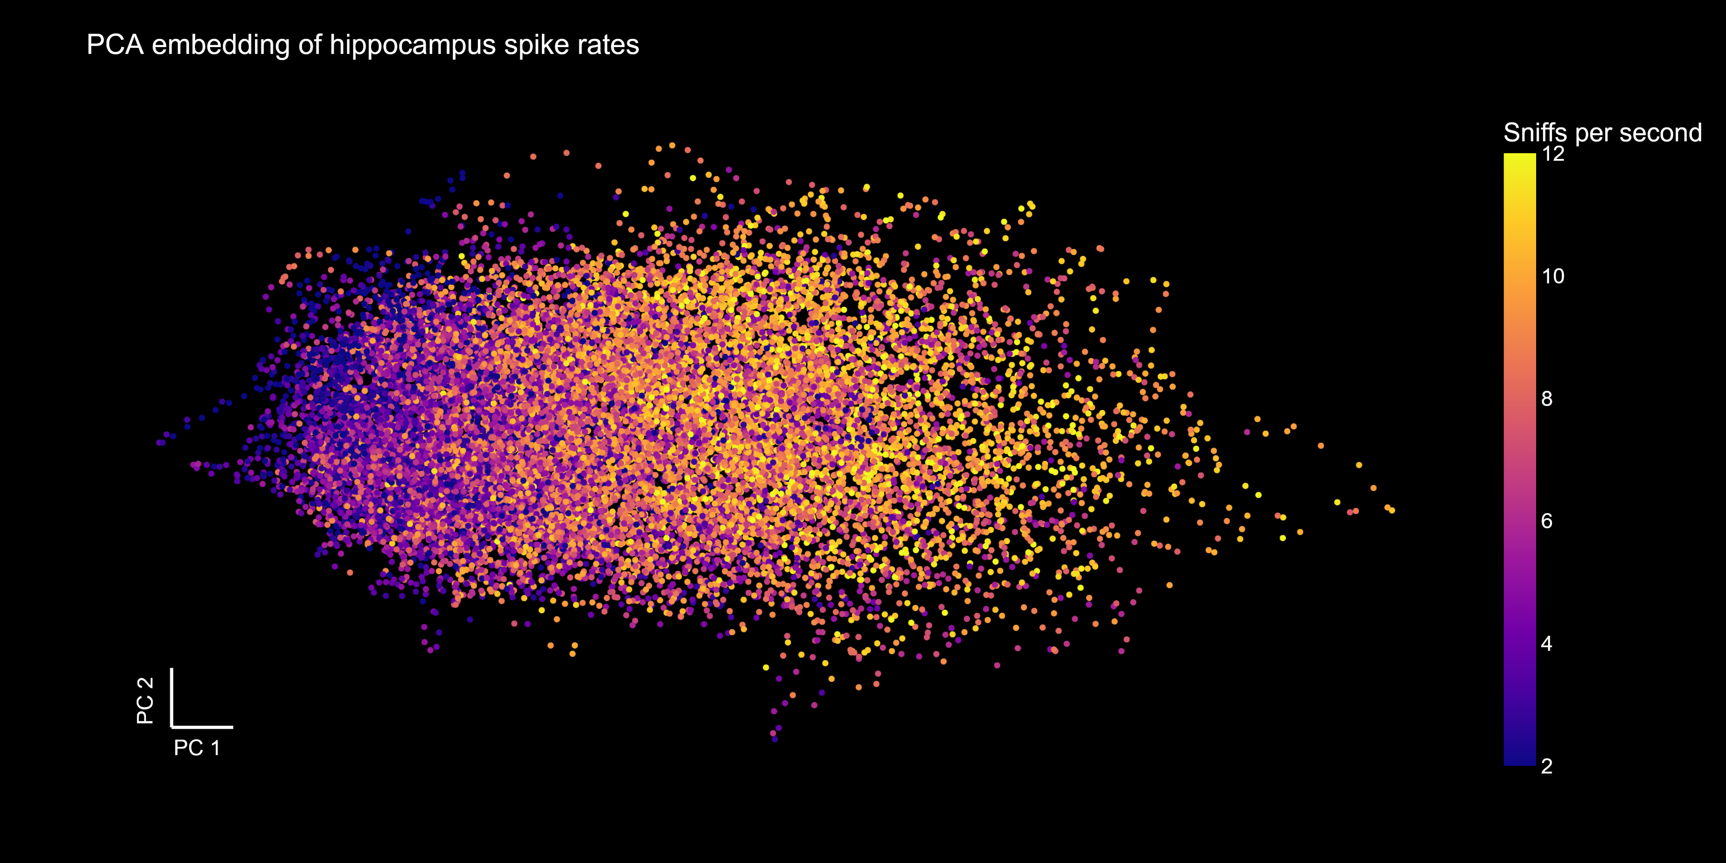
6002/0

Slide 23
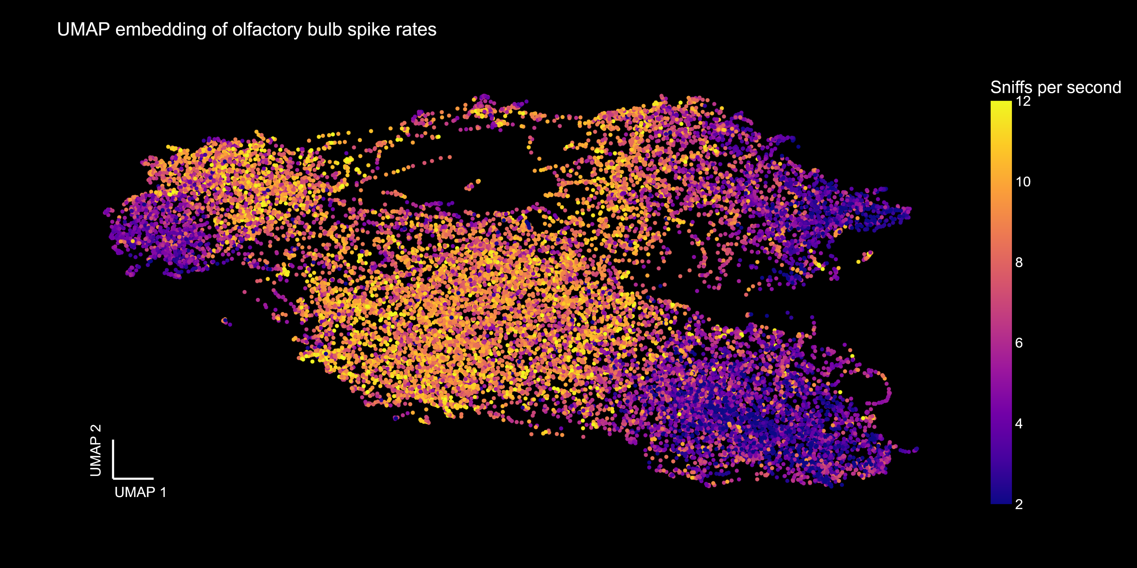
6002/0

Slide 24
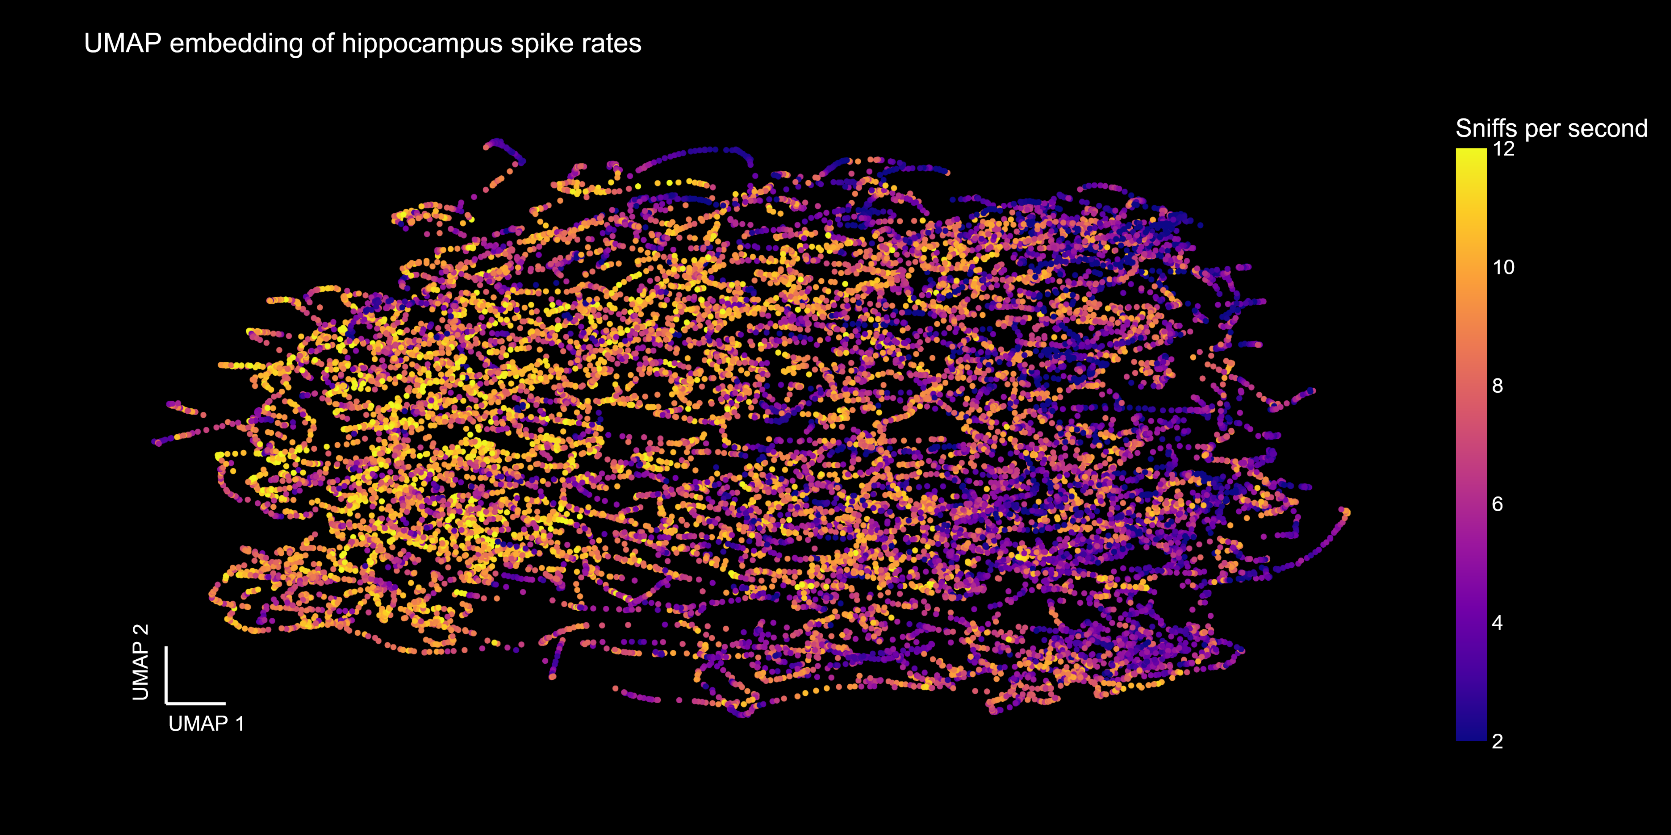
6002/0

Slide 25
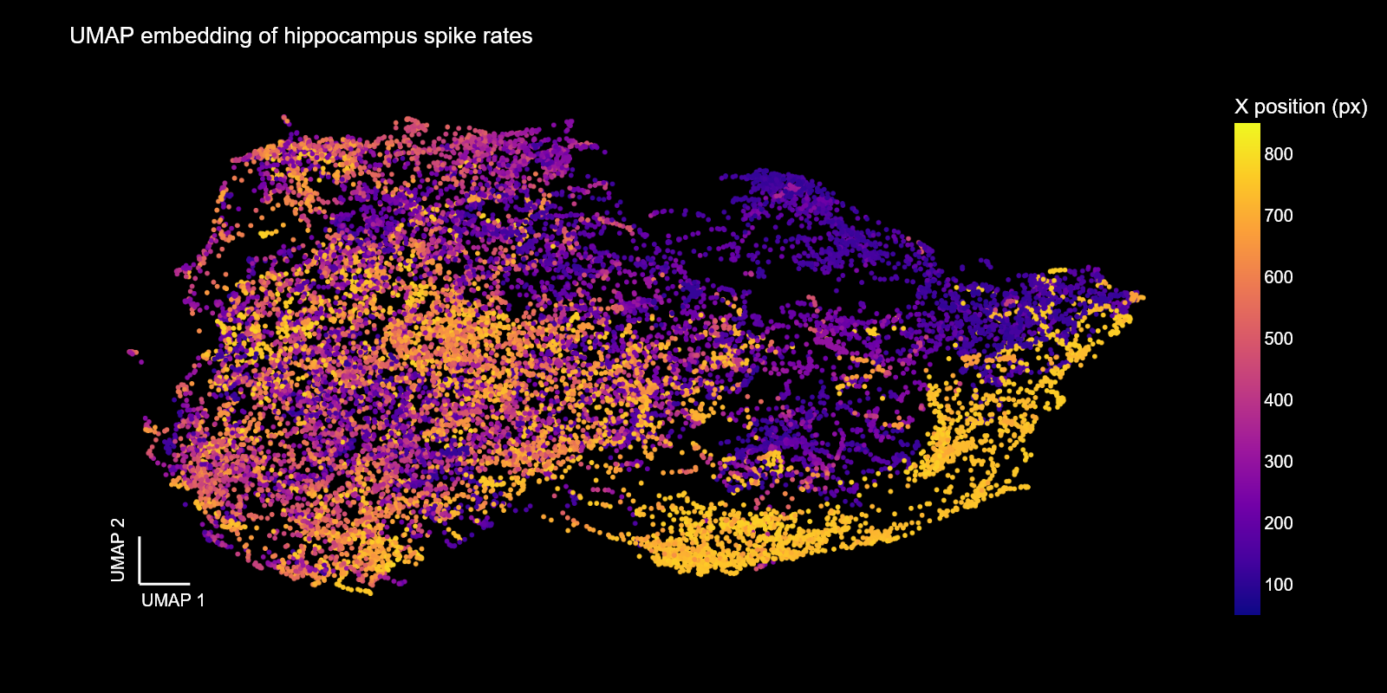
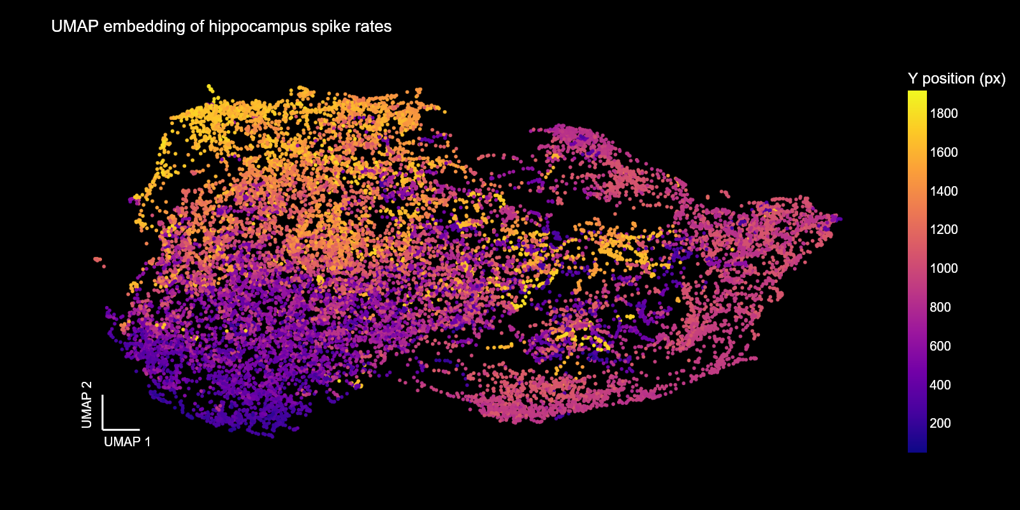
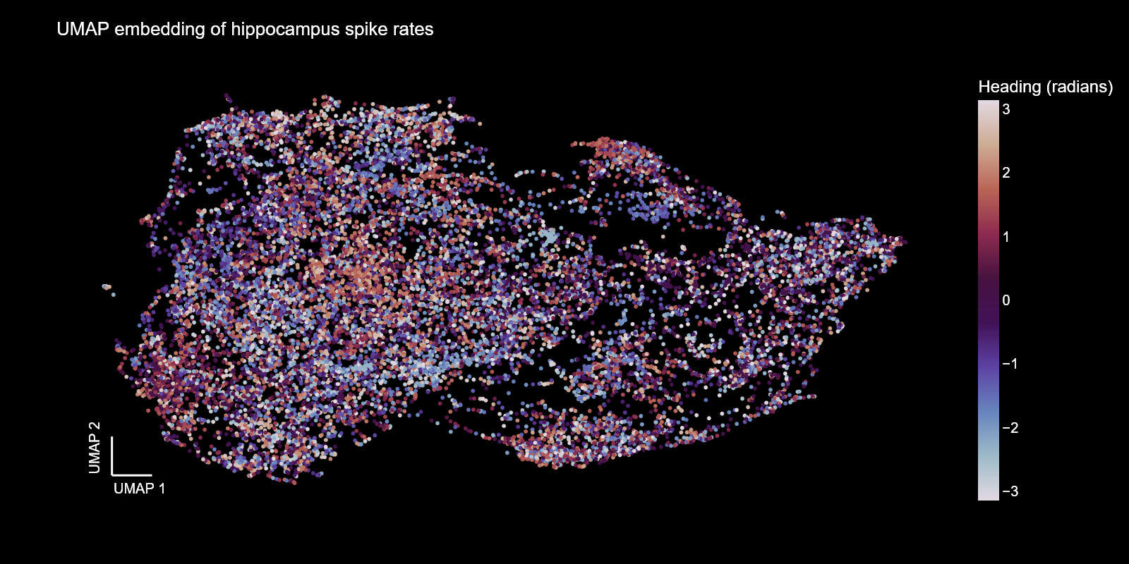
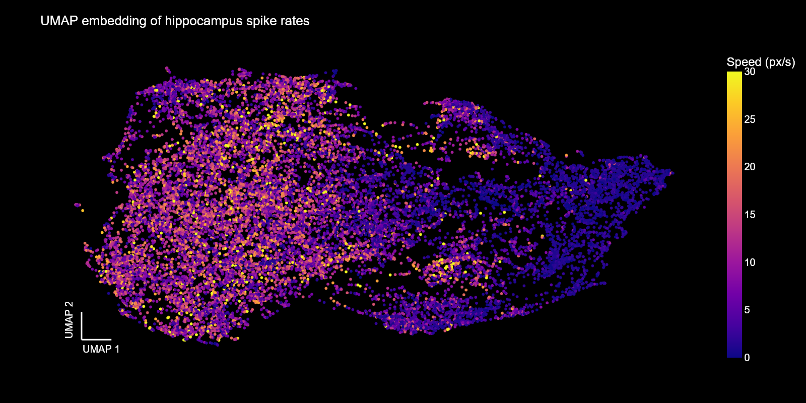
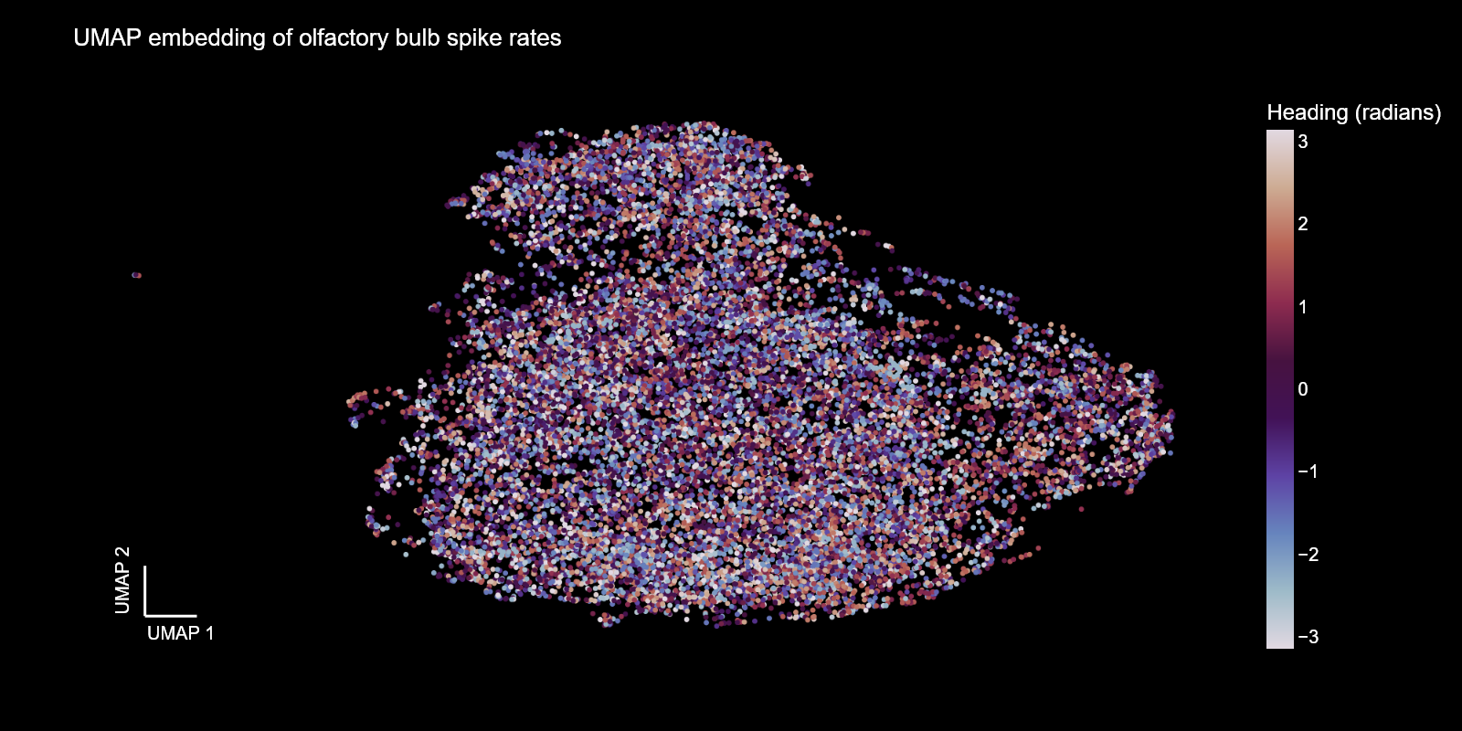
The hippocampus as a cognitive map
6002/12

Slide 26
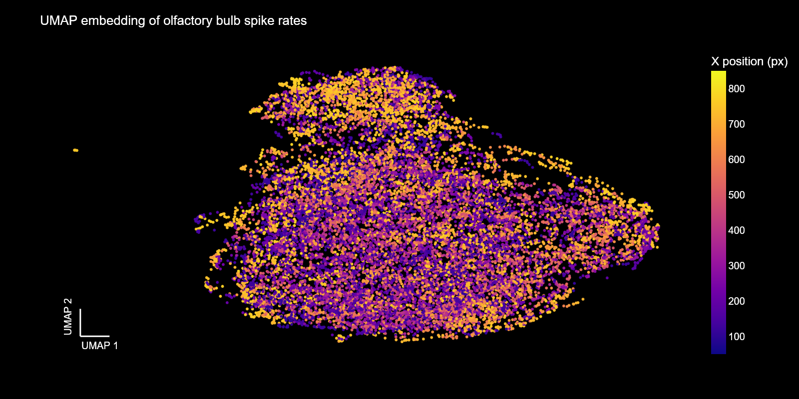
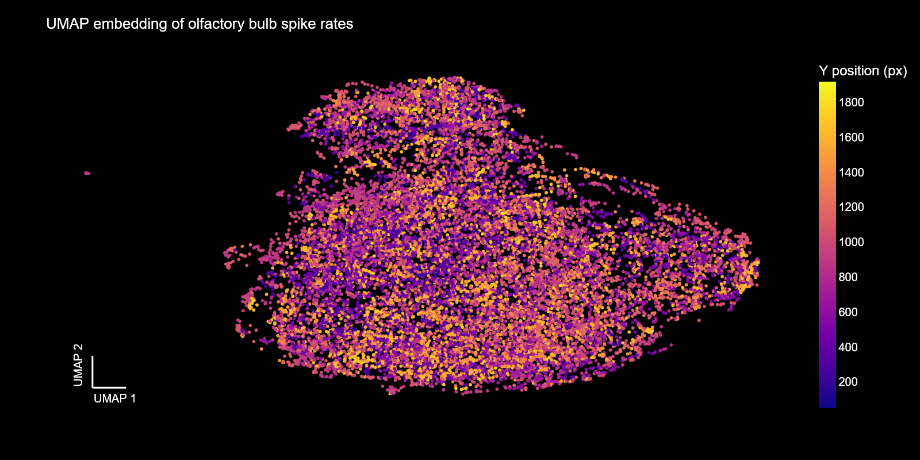
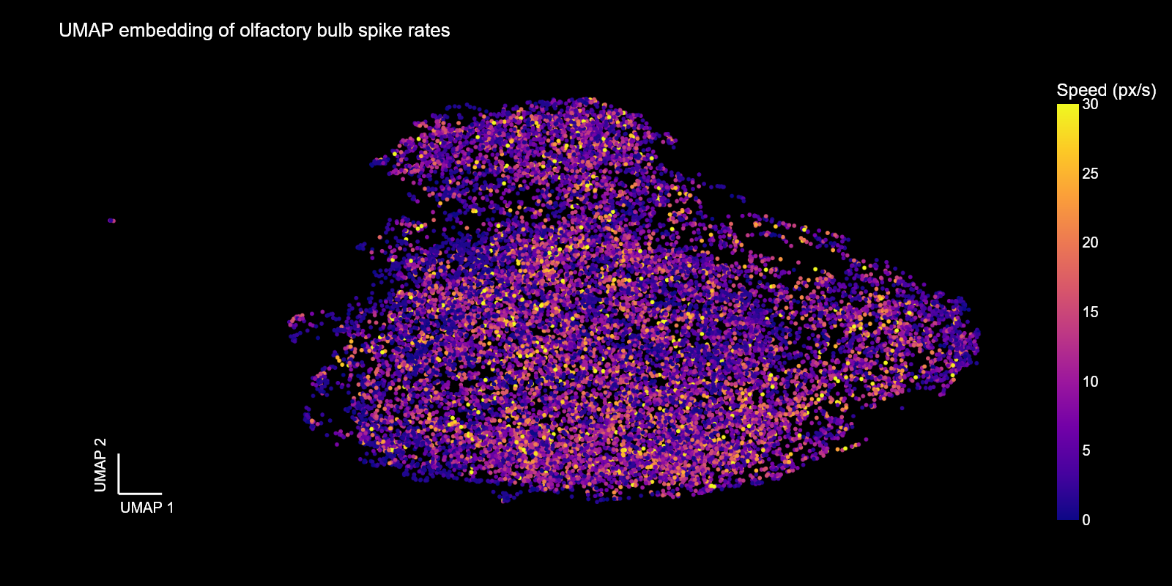
Olfactory bulb population activity
6002/12

Slide 27
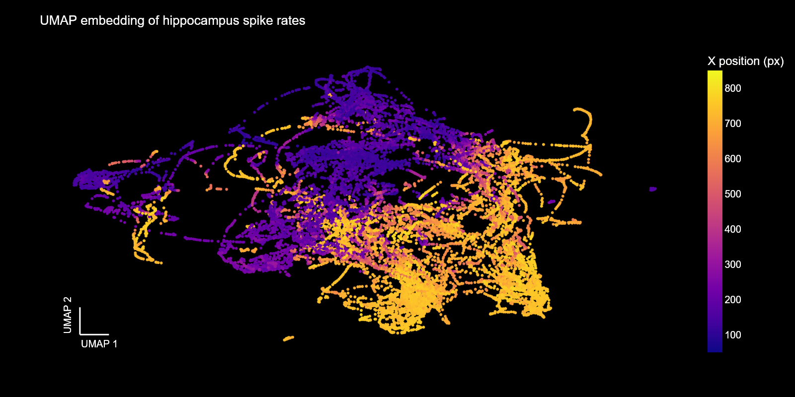
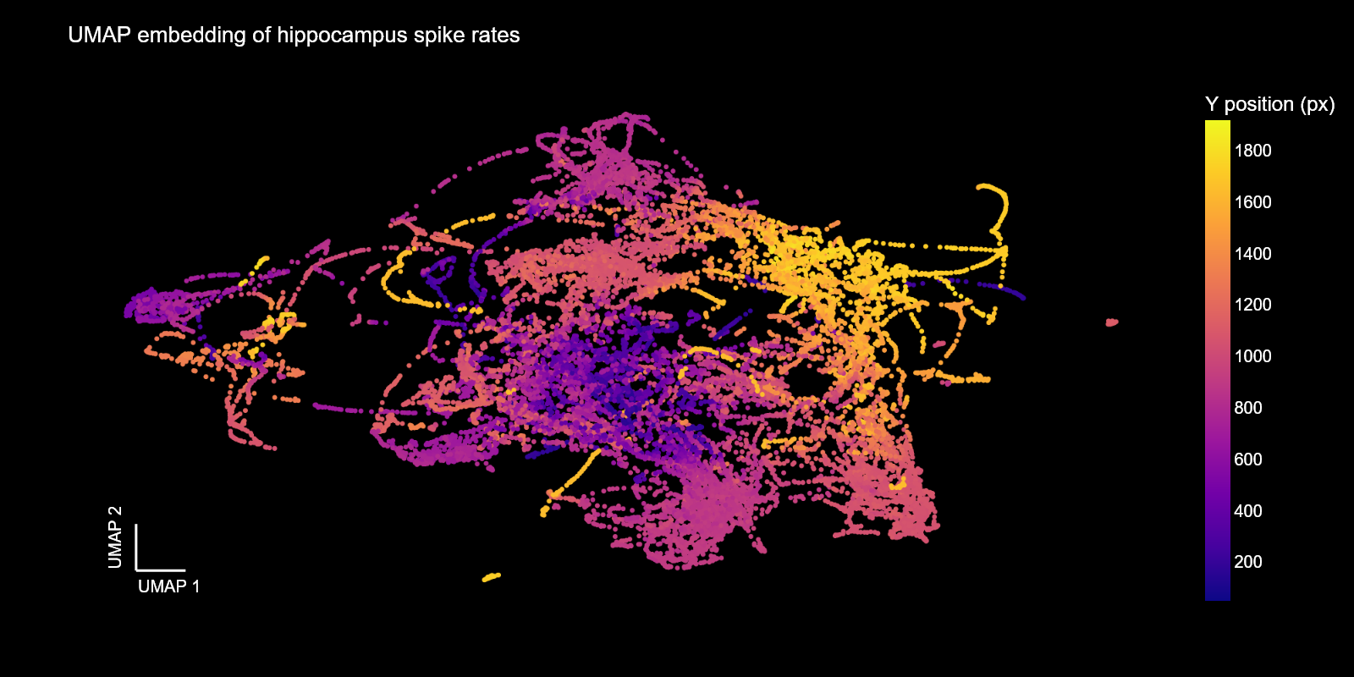
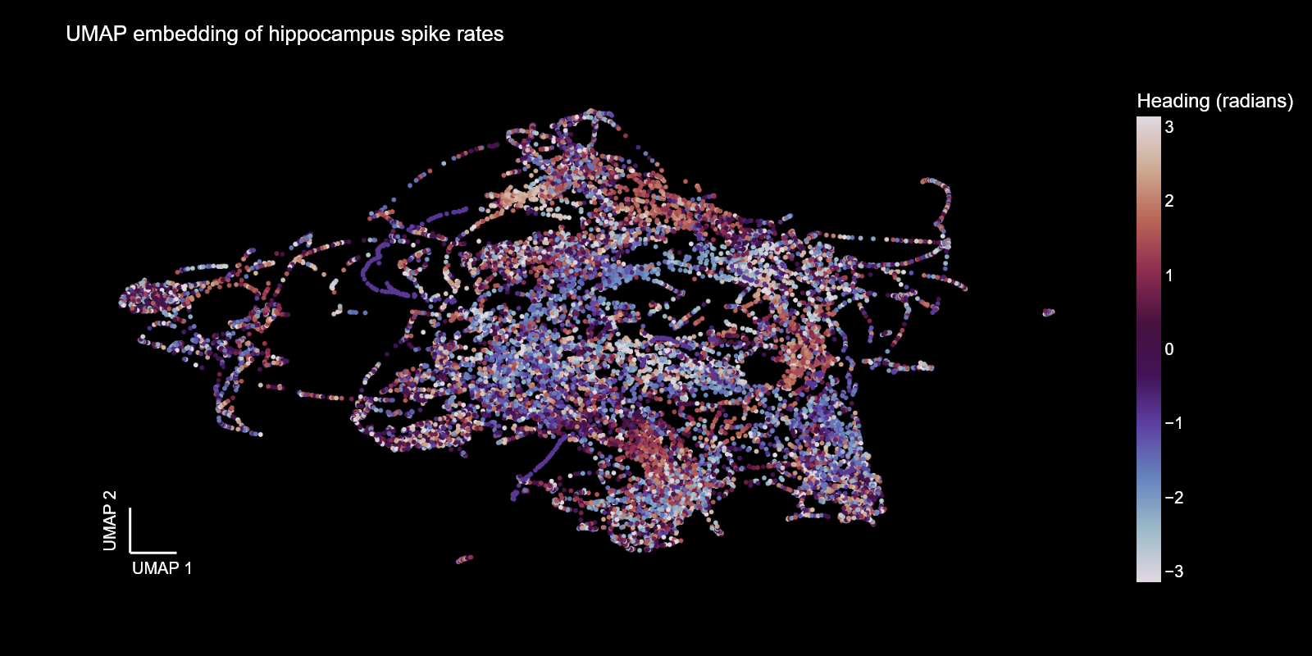
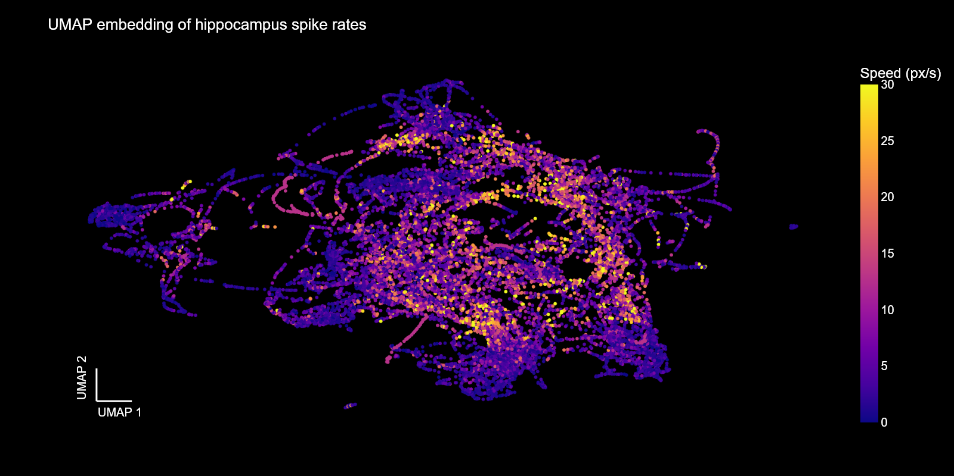
The hippocampus as a cognitive map
6002/7

Slide 28
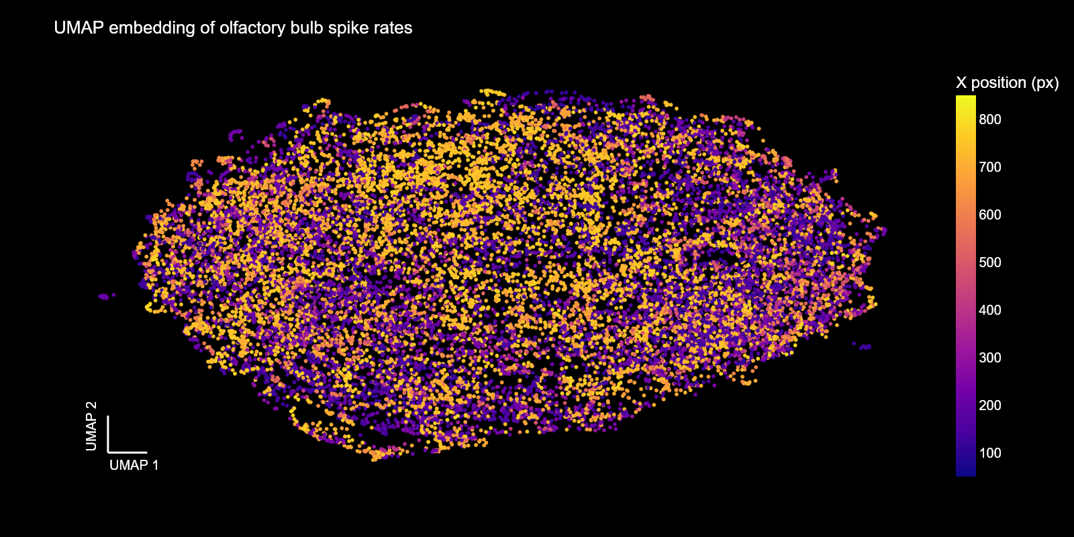
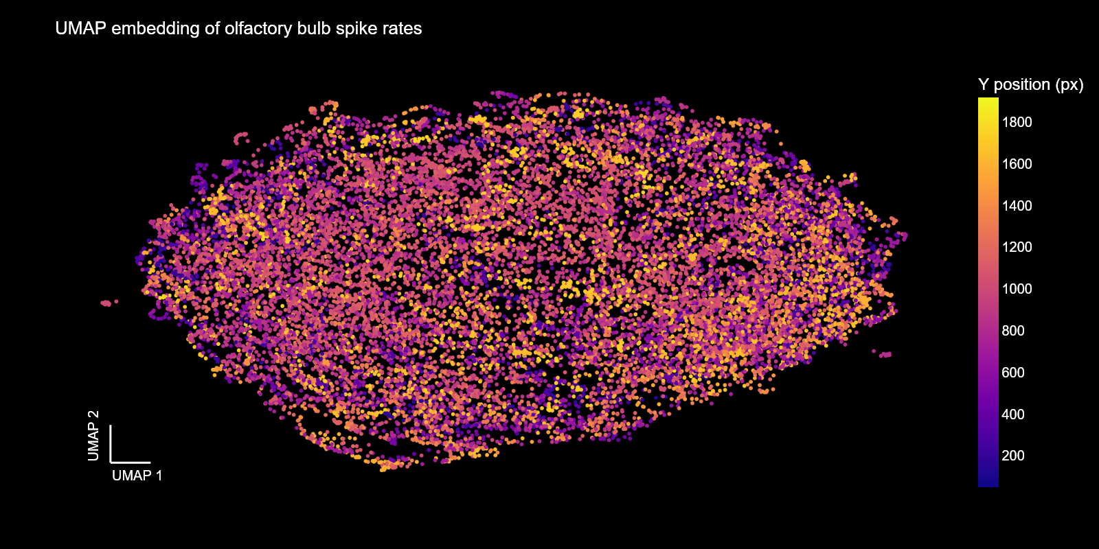
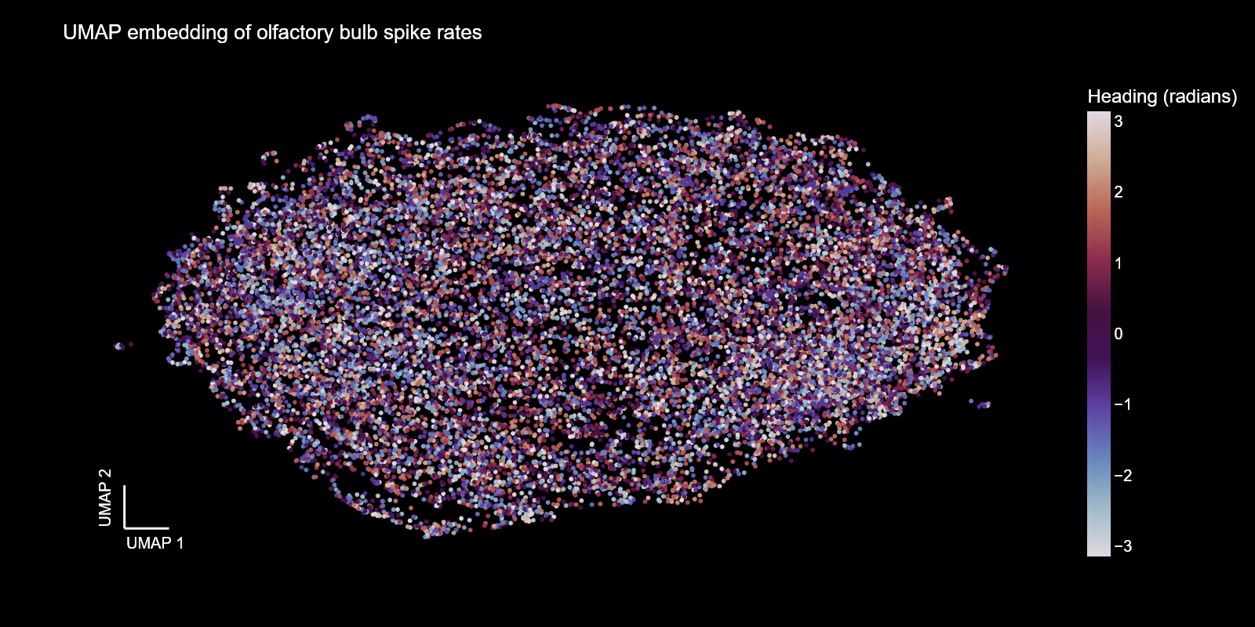
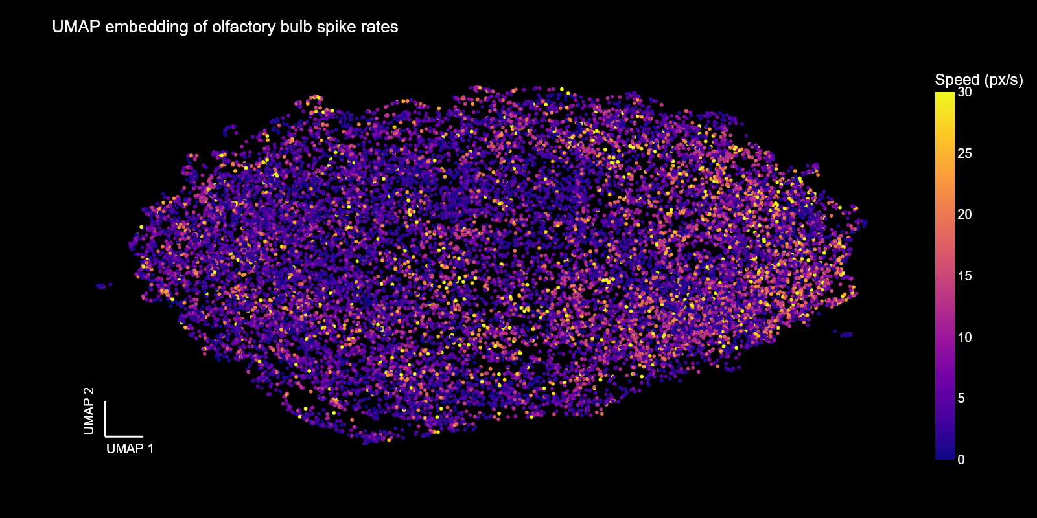
Olfactory bulb population activity
6002/7

Slide 29

Local field potentials
LFPs were extracted with an order 4 Butterworth filter and down sampled to 1Khz
Theta ($θ$): 2-12Hz
Beta ($β$): 18-30Hz
Gamma ($γ$): 65-100Hz
PSD was estimated using Welch’s method in 4s windows with 50% overlap
The envelope was estimated by taking the absolute value of the Hilbert transformed signal

Slide 30
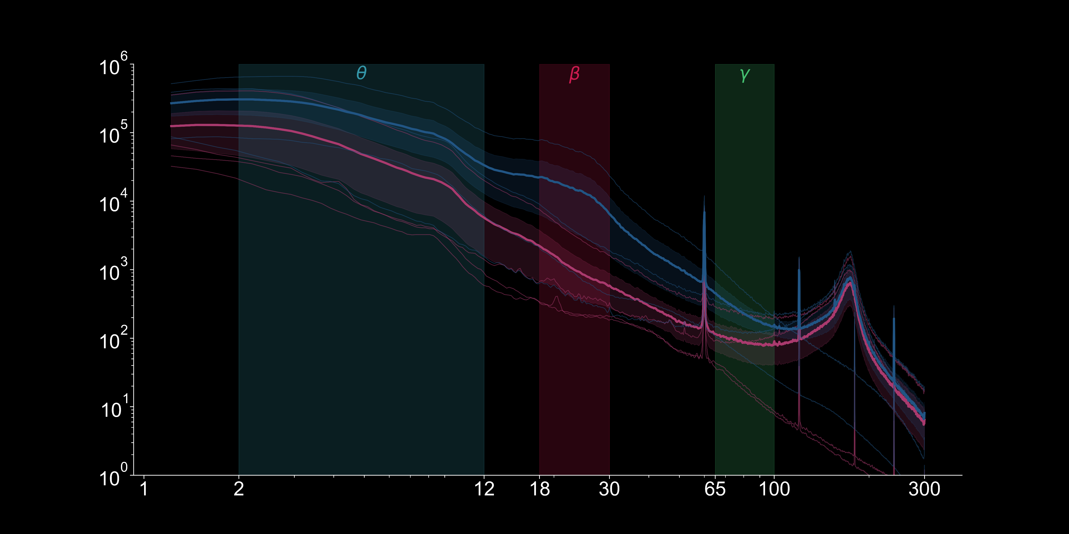
Local field potential power spectrum
Olfactory bulb
Hippocampus
Power spectral density
Frequency

Slide 31
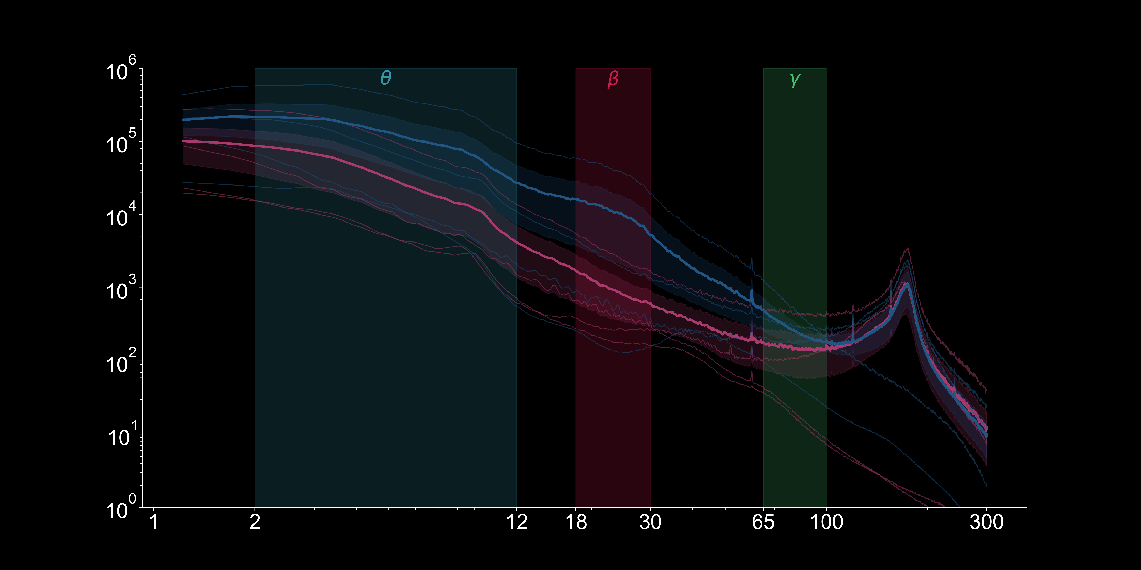
Local field potential power spectrum
Olfactory bulb
Hippocampus
Power spectral density
Frequency

Slide 32
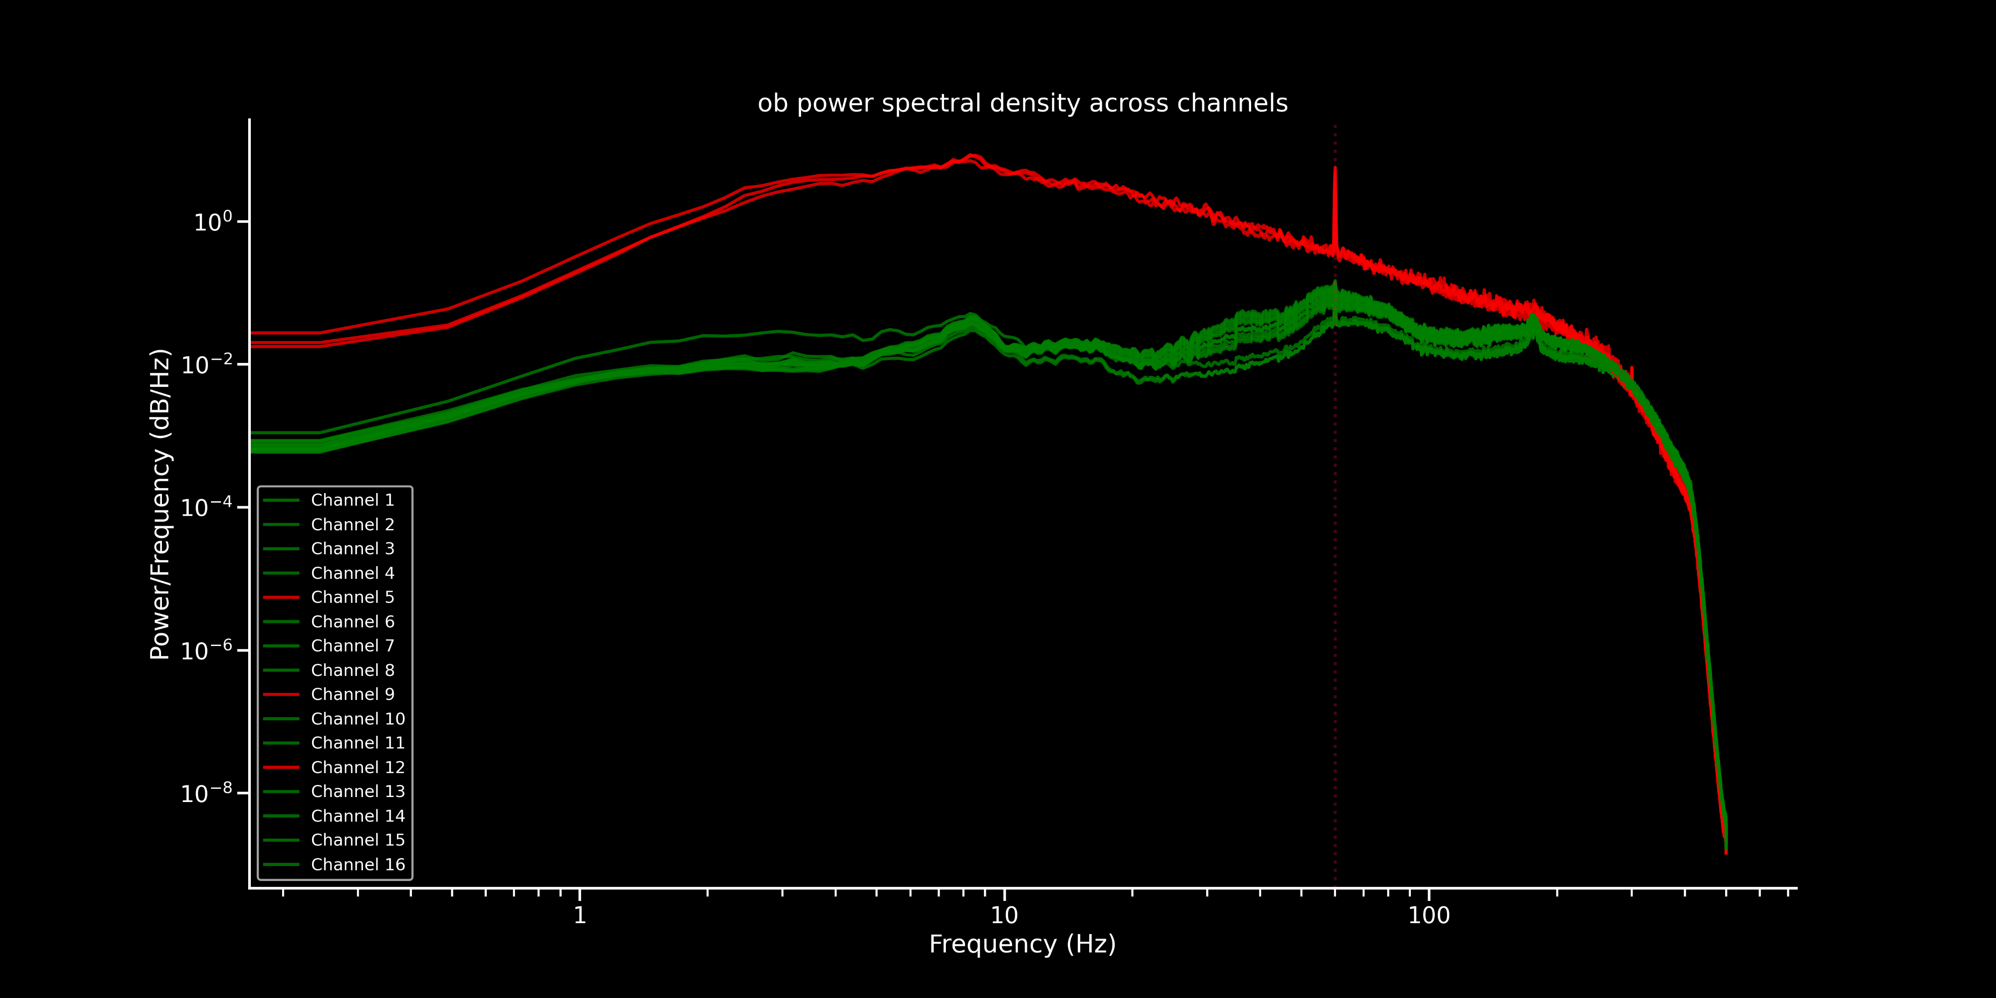
Local field potential power spectrum
Noise
Good

Slide 33
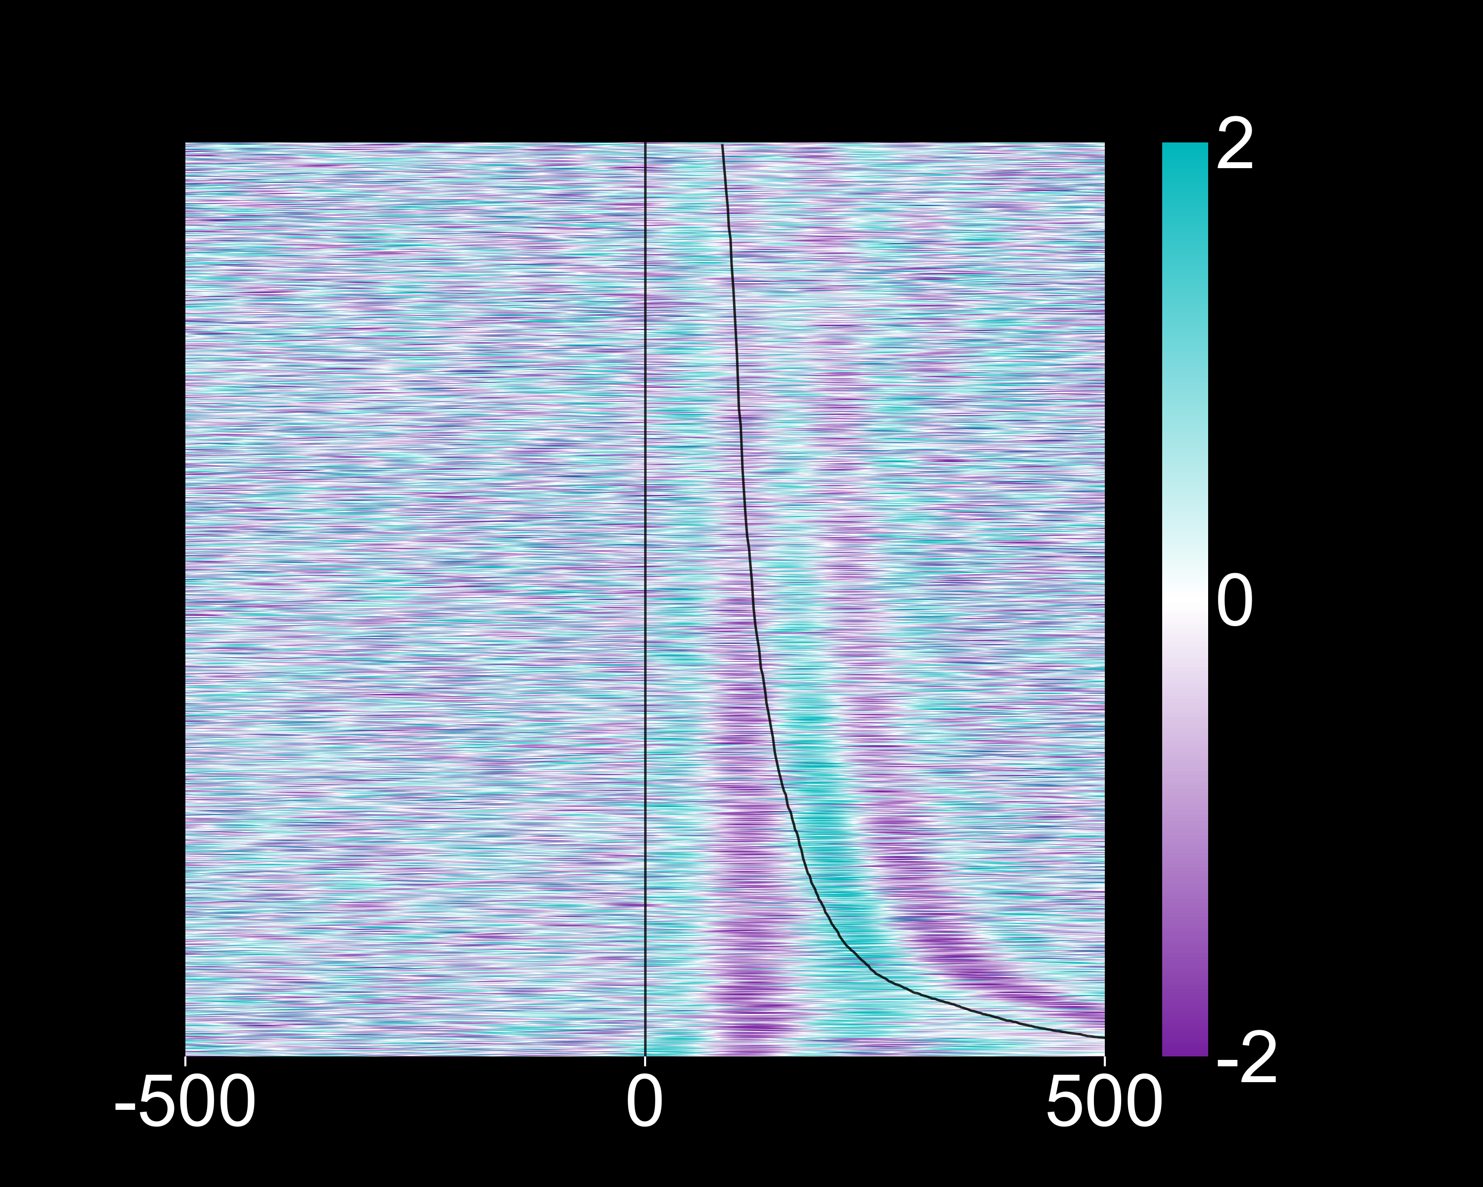
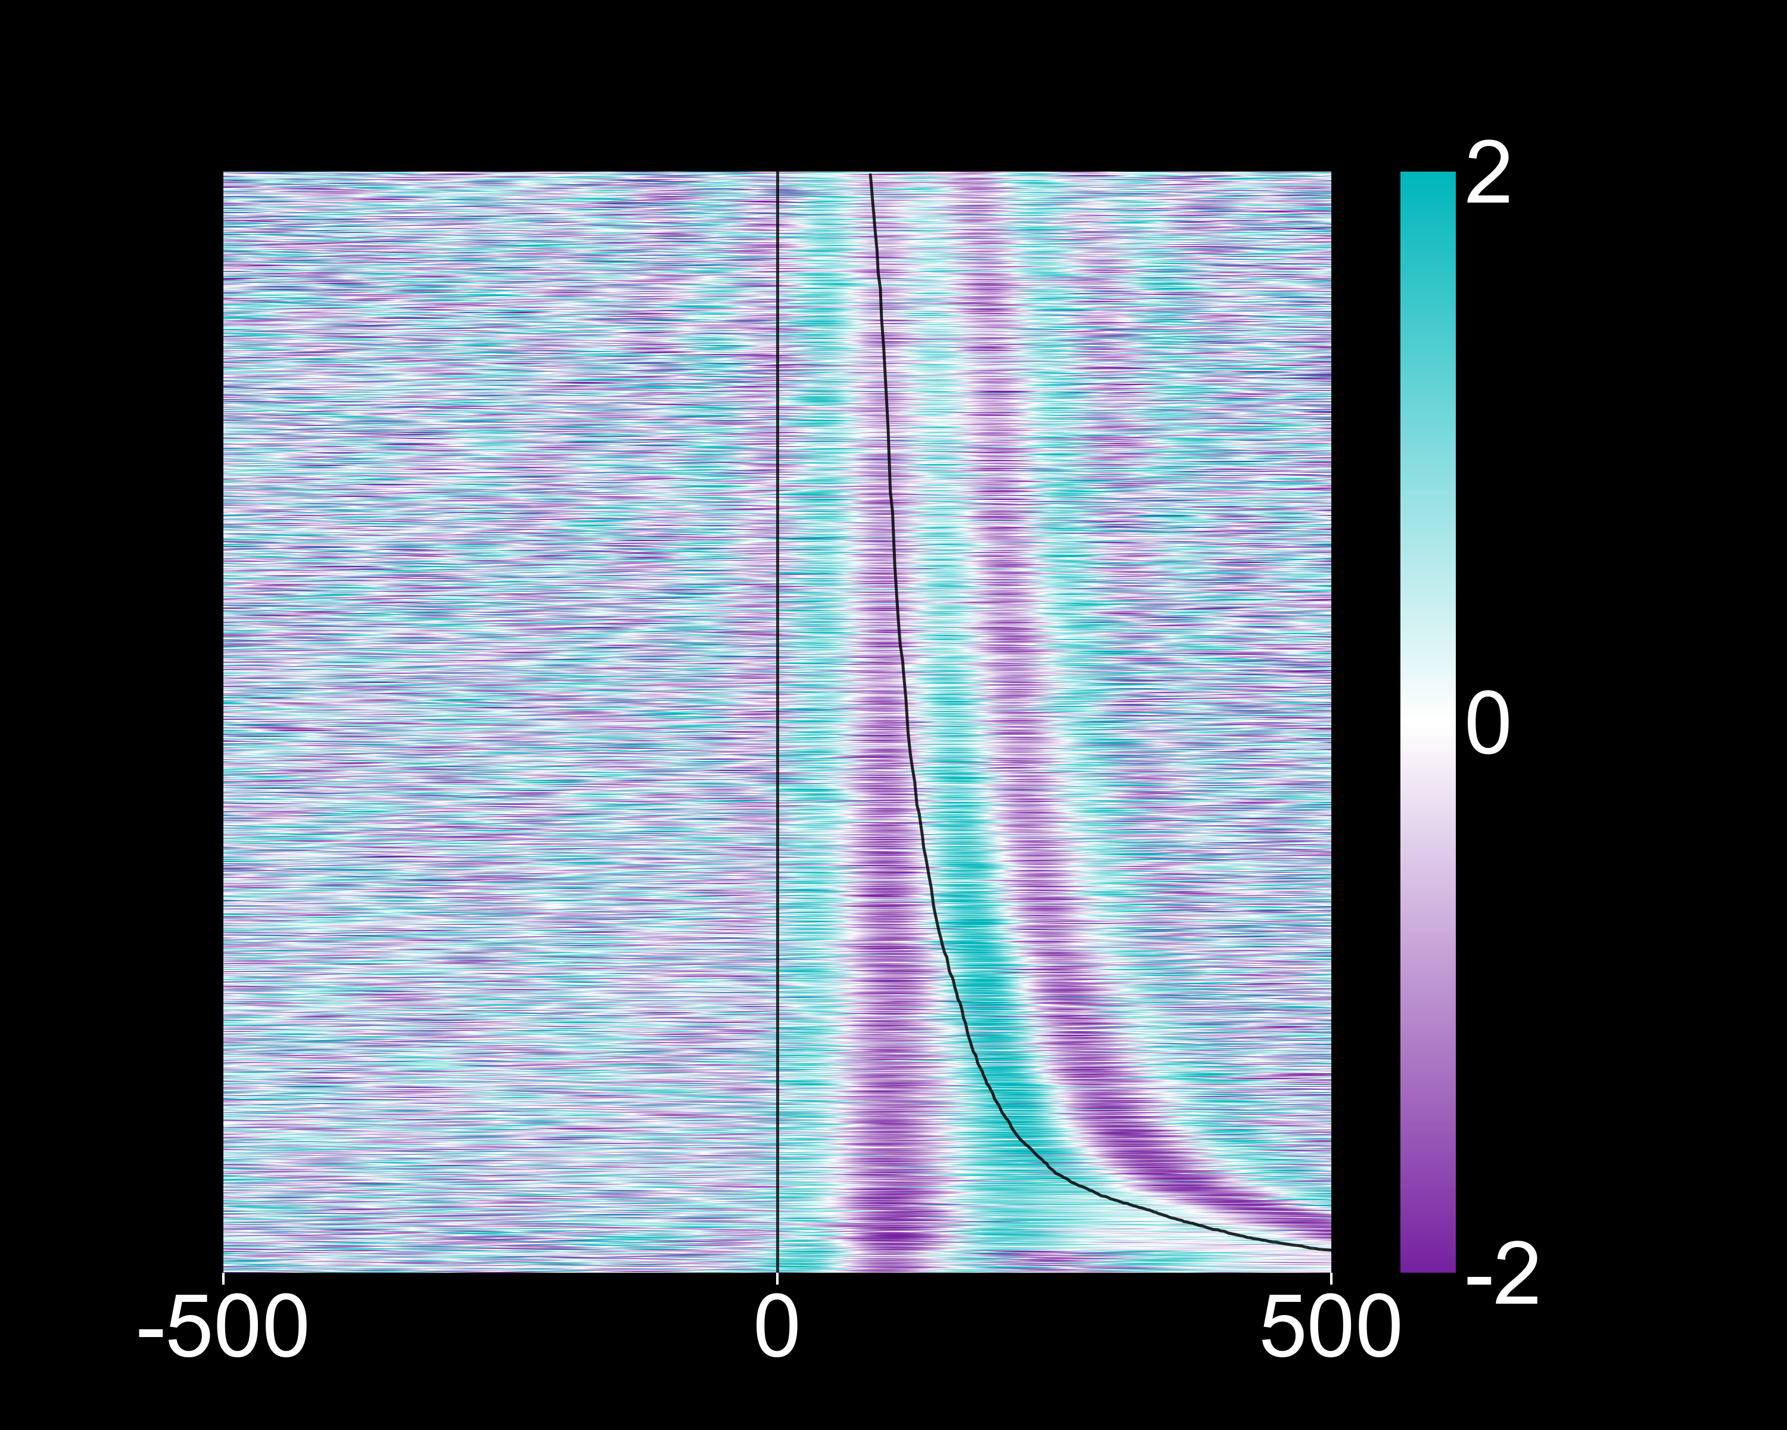
Inhalation aligned local field potentials
Theta “θ” band (2 – 12Hz)
Hippocampus
Olfactory bulb
Sorted by sniffs per second
Amplitude (σ)
Time from inhalation (ms)

Slide 34
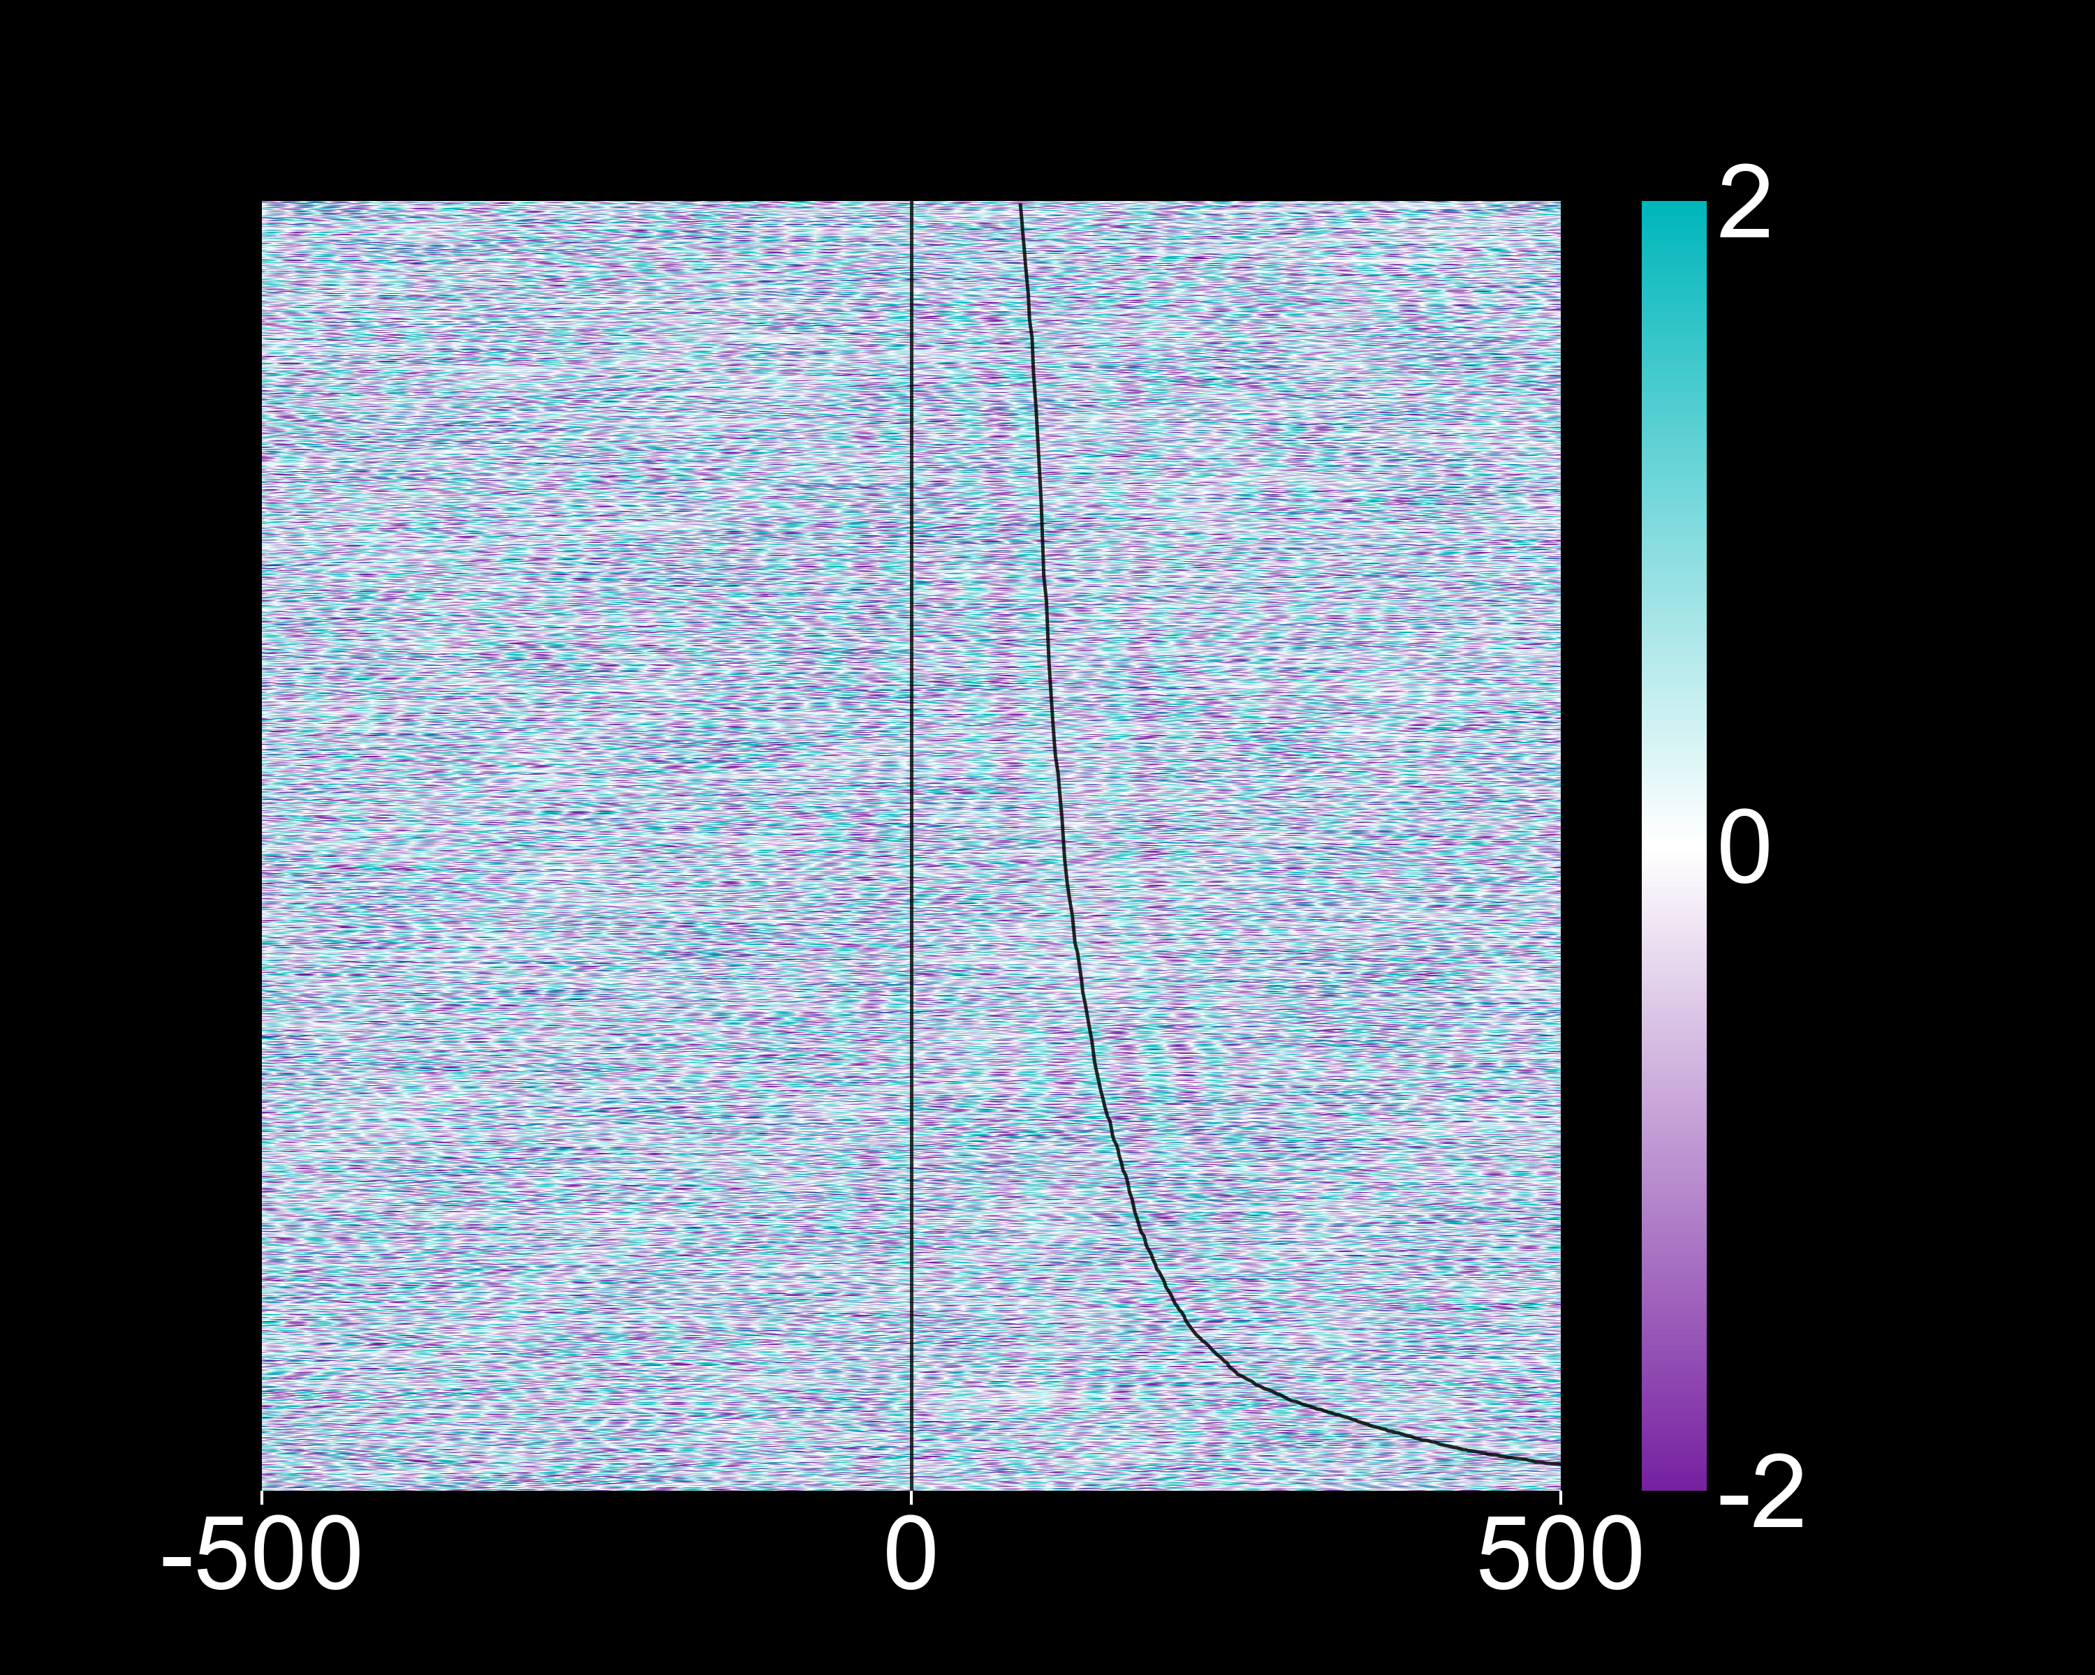
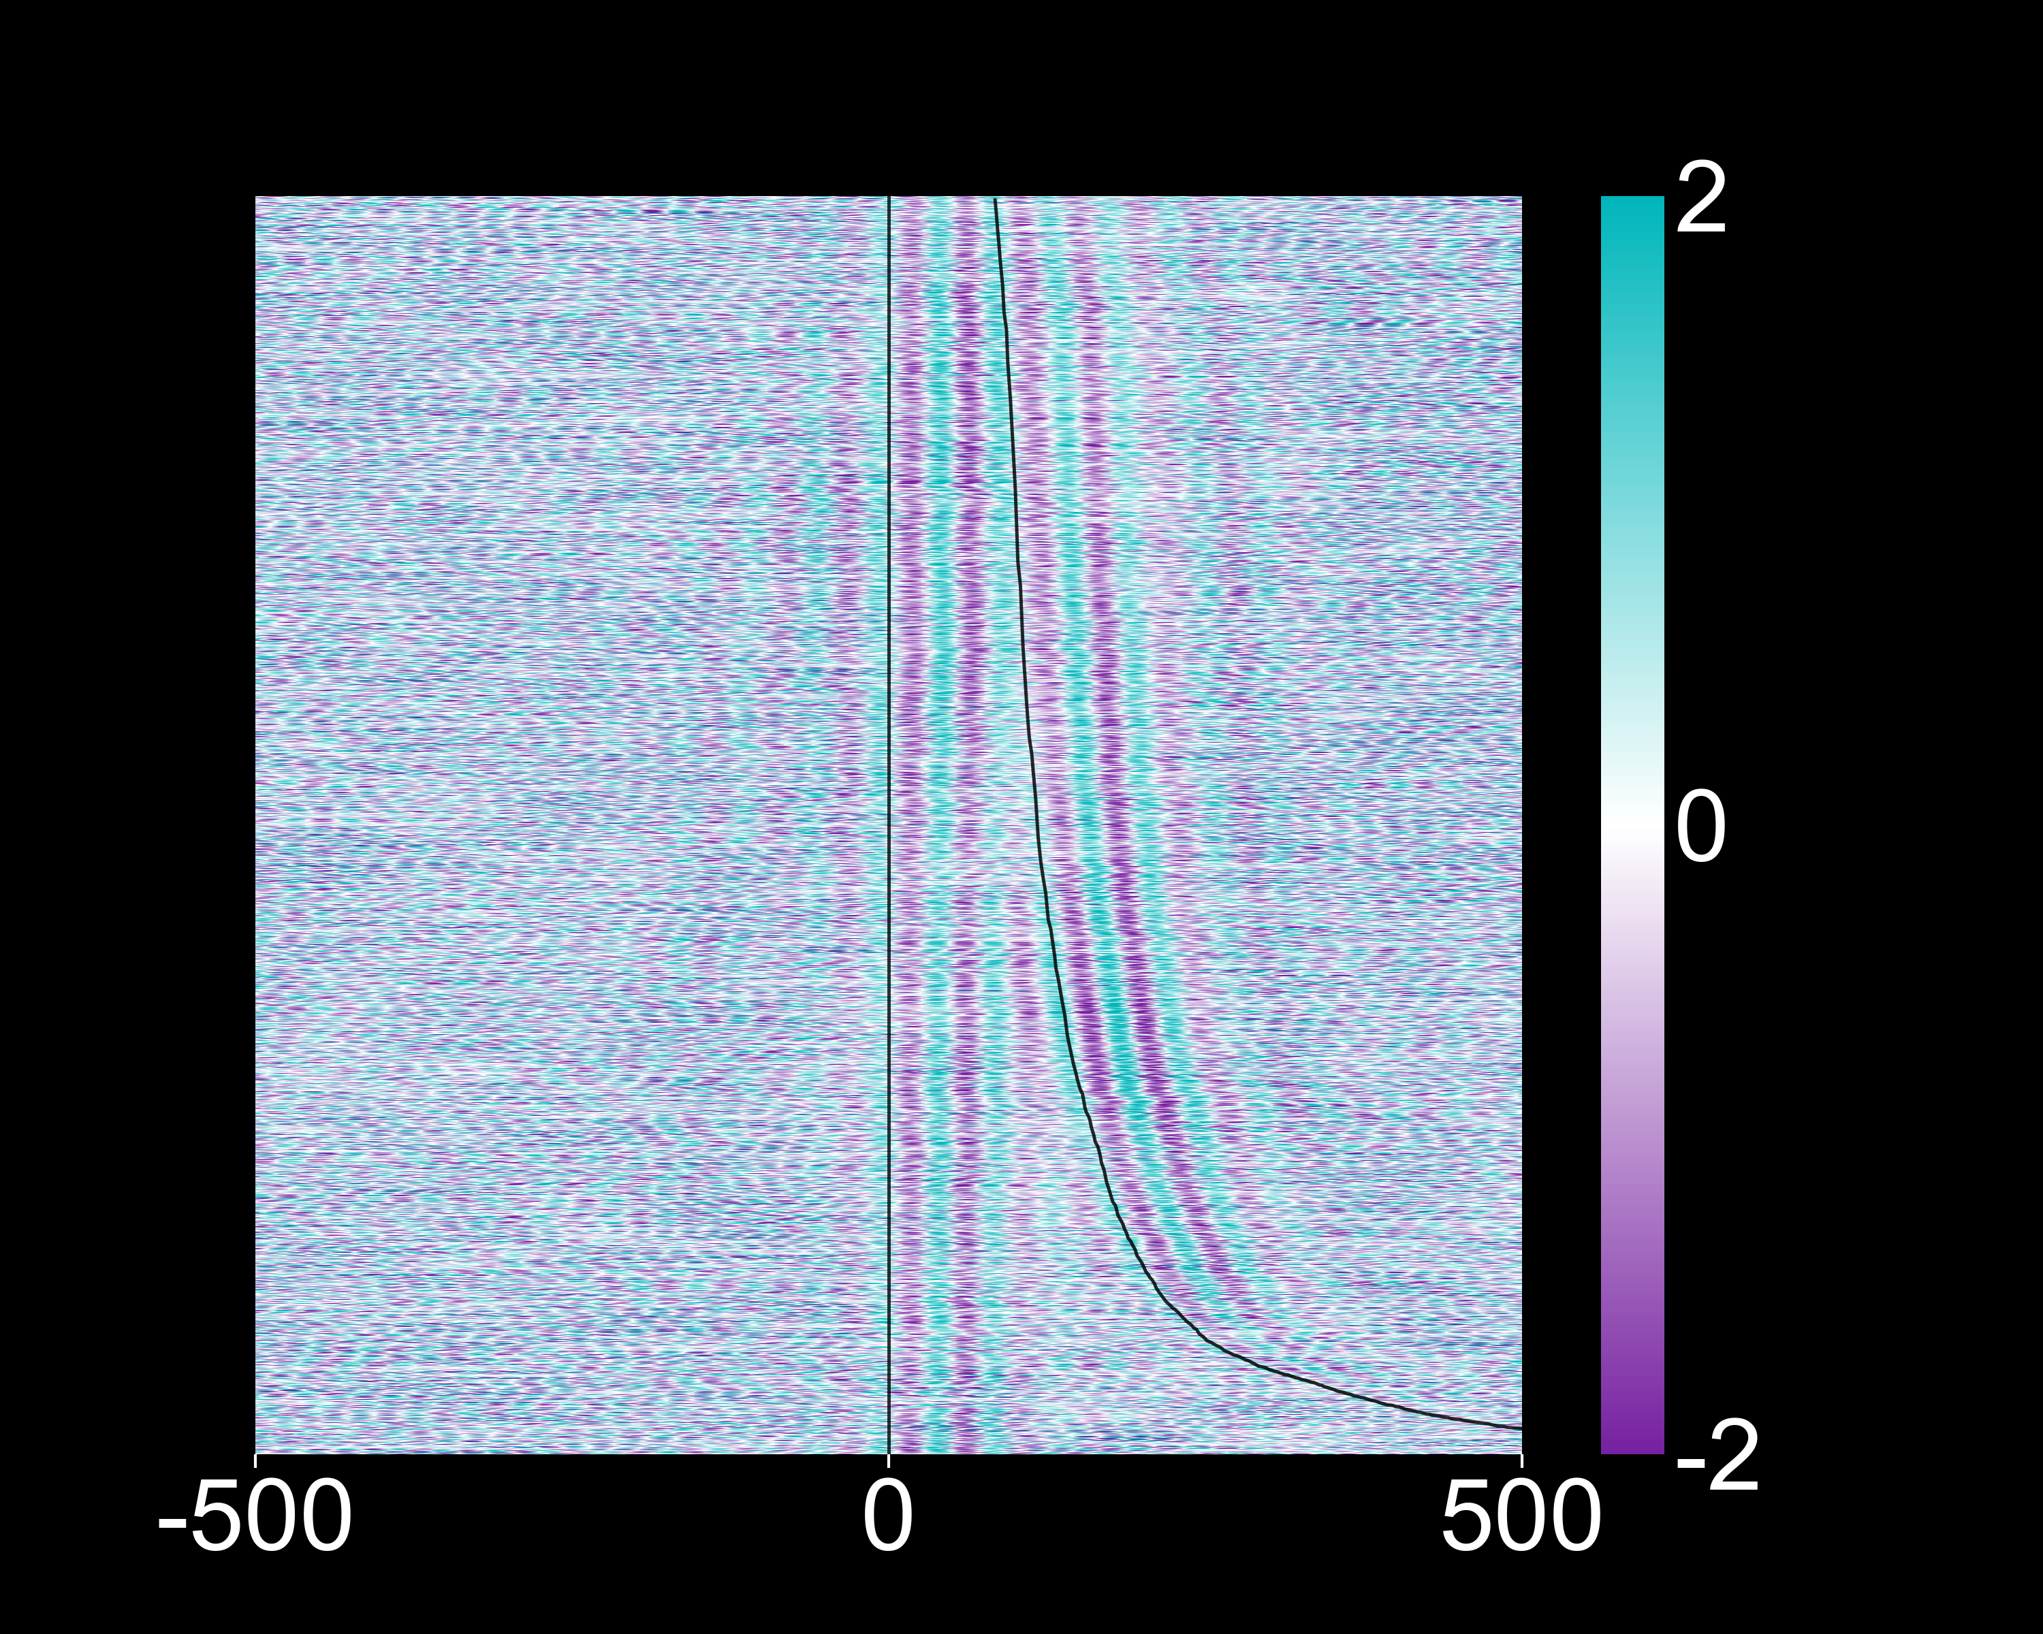
Inhalation aligned local field potentials
Beta “β” band (18 – 30Hz)
Hippocampus
Olfactory bulb
Sorted by sniffs per second
Amplitude (σ)
Time from inhalation (ms)

Slide 35
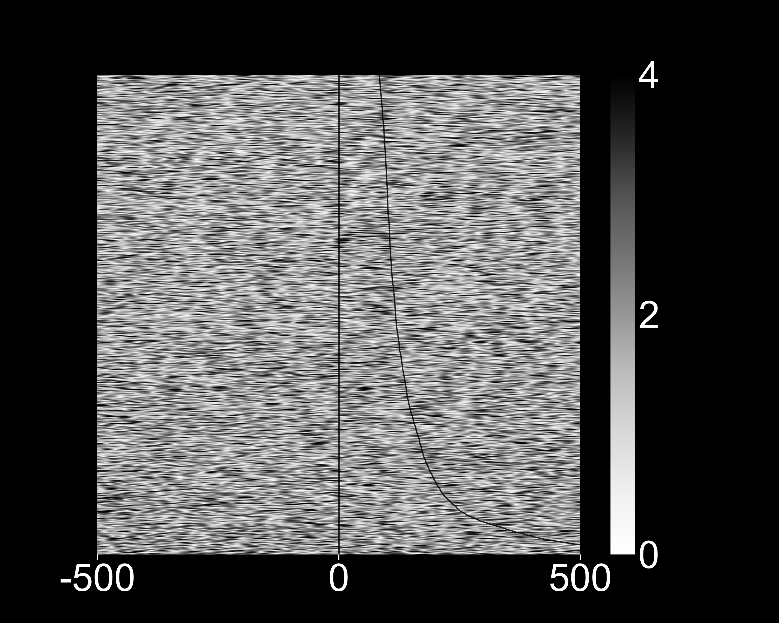
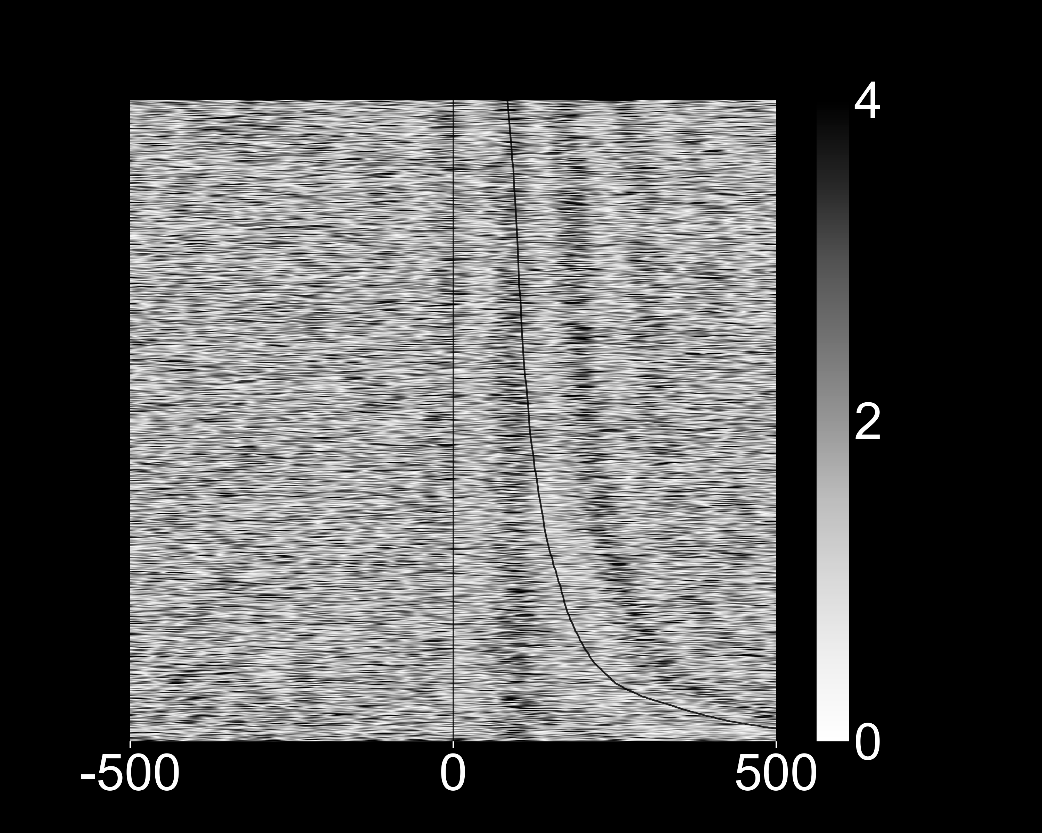
Inhalation aligned local field potentials
Gamma “γ” band (65 – 100Hz) envelope
Hippocampus
Olfactory bulb
Sorted by sniffs per second
Amplitude (σ)
Time from inhalation (ms)

Slide 36
Inhalation aligned olfactory bulb spiking activity
Inhalation onset
Next inhalation
6002/0 cl 37
6002/0 cl 42
Sorted by sniffs per second
-250
0
250
-250
0
250
Time from inhalation (ms)

Slide 37

Inhalation aligned hippocampal spiking activity
Inhalation onset
Next inhalation
6002/3 cl 13
6002/0 cl 19
Sorted by sniffs per second
-250
0
250
-250
0
250
Time from inhalation (ms)

Slide 38
Current and Future Directions

Slide 39
Olfaction/Anosmia and Depression
1: How does disrupting olfactory inputs affect OB and HC activity?
What activity are we disrupting? Does place information come through the nose? Is it part of the recurrent network with the HC?
2: Is this disruption correlated with or causing depressive symptoms?
Are LFP and spikes still aligned to inhalation? Does disrupting synchrony affect brain states?

Slide 40
Injections
100 mg/kg methimazole (MMZ)
Ablated olfactory epithelium
pre-injection
48 hours post-injection

Slide 41


MMZ affects sniffing behavior (previous results)

Slide 42
Behavioral Observations/Confounds
Mice move, eat, and drink much less, sniff less frequently, and are lethargic post injection.
Possible factors:
Ablation is causing disruption in neural activity
MMZ side effects
Acute toxicity can lead to myxedema coma (severe hypothyroidism)
Happening simultaneously?

Slide 43
Next Steps
Quantify place contribution to spike rates with GLM.
Decode place with Kalman filter, SVM, neural network.
Analyze LFPs, spiking, and behavior in post-injection data and compare with current findings.
SLEAP tracking
Cohort 2
Powered commutator
VR room rotation

